Slide 1

Design and implementation of scientific databases
László Dobos
Eötvös Loránd University Dept. of Physics of Complex Systems
© 2015 ELTE
Supported by the Higher Education Restructuring Fund allocated to ELTE by the Hungarian Government

Slide 2
Outline
The fourth paradigm
Living in an exponential world
Amdahl’s laws
High performance x64-based hardware
Storage systems
Redundant disk systems
Storage system software layers
Benchmarking
Networks
Databases
Physical storage schemes
Indexes
Physical operators
Query optimization
Transactions
Backup and replication
Data loading
Meta data
Multidimensional data
Indexing the sphere
GIS in MS SQL
Advanced storage techniques
RDBMS in the future
Array stores
noSQL databases
Consistency of distributed databases

Slide 3
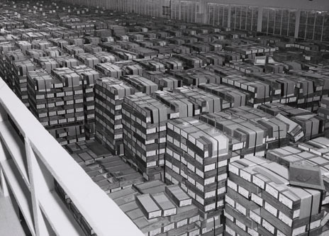
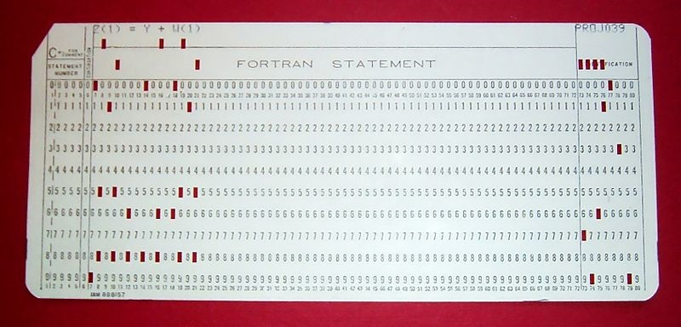
Data tsunami 1959
4GB of punched cards

Slide 4
1. The Fourth Paradigm
Or how data mining became a new method of science equivalent to theory, experiments and simulations

Slide 5
Evolution of the scientific method
Experiment
Theory

Slide 6
Evolution of the scientific method
Experiment
Theory
Simulations

Slide 7
Evolution of the scientific method
Experiment
Theory
Simulations
Data Mining

Slide 8
Modern scientific experiments
Automated data acquisition
Telescopes
Particle accellerators
Gene sequencers
Satellites
Sensor networks
Internet measurements
Large data volume
Today typically o(100TB)
Soon o(1PB)
Data are filtered automatically during experiments
Data are on-line
On spinning disks
24/7 access
Typical computational problems
Raw data preprocessing
Statistics on large samples
Time-series analysis
Machine learning
Outlier detection
Human interaction with the data
Visualization
Data manipulation languages

Slide 9
Astrophysics
Sky Surveys
Systematic maps of the night sky
For astrostatistics
Structure of the Milky Way
Structure of the Universe
Ecolution of galaxies
Cosmology
Many wavelength ranges
Radio, IR, optical, UV, X, γ
Comparing emission at various wavelength ranges is fundamental
Dark matter simulations
Millenium, Bolshoi, Indra
10^9-10^10 particles in time and space
Gravity wave detection
LIGO, Virgo, LISA
Time-series analysis
Past
Palomar Observatory Sky Survey
Digitized glass plates
Yesterday
Sloan Digital Sky Survey o(10TB)
SkyServer [Szalay et al.]
350 million detected objects
1.5 million spectra
A small part of the sky was observed in time-domain
Today
PanSTARRS o(100TB)
Time-domain observations
Solar system moving objects, variable stars, quasars, active galaxies
By the end ot the decade
LSST o(1 PB)

Slide 10
Particle physics
Particle accelerators
Tevatron, RHIC, LHC
Huge 3D detectors to trace particle trajectories
World’s largest „digital cameras”
Millions of events per second
Filter events during data collection
Save only interesting data
Off-line analysis, data mining
Object-oriented databases
Particle decay graphs
Skimming: read through all data, filter out interesting

Slide 11
Biology and medicine
Mechanics
Turbulent flows
MHD, plasma physics
DNA sequences
Protein networks
Sensor networks in oceonography, ecology
Cancer research: disease

Slide 12
Geology, meteorology, oceonography etc.
Geo-informatics Systems (GIS)
Maps, data points on the map
Raster databases
Satellite images
Seizmology
Thunderstrike maps
Ocean currents

Slide 13
2. Living in an exponential world

Slide 14
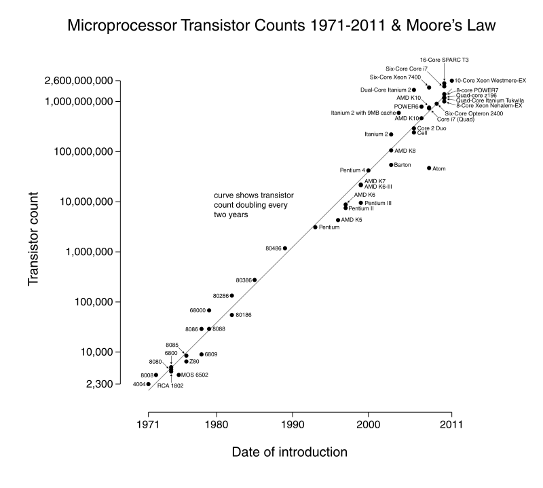
Driving force: Moore’s law
The number of transistors/chip doubles every 18 months

Slide 15
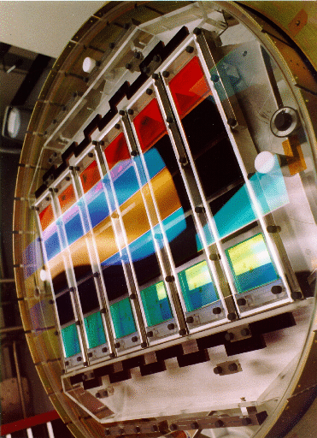


Exponential growth
Electronics
Detectors
Data size

Slide 16
Exponential growth of databases

Slide 17

Tractable algorithms
Data size ∝ e^{t}
Computational capacity ∝ e^{t}
Tractable algorithm o(N)
Any algorithm harder than o(N log N) is not tractable
A⁻¹

Slide 18
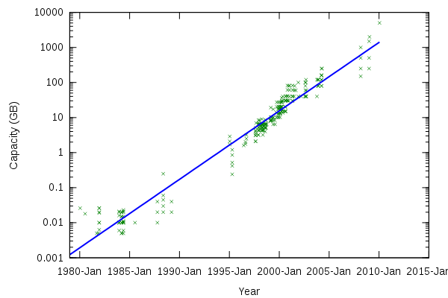
Storage capacity of disks
SMR technology
PMR technology
GMR technology

Slide 19

Reading a 1 TB disk
Sequentially 4.5 hours
Random access 15-150 days

Slide 20
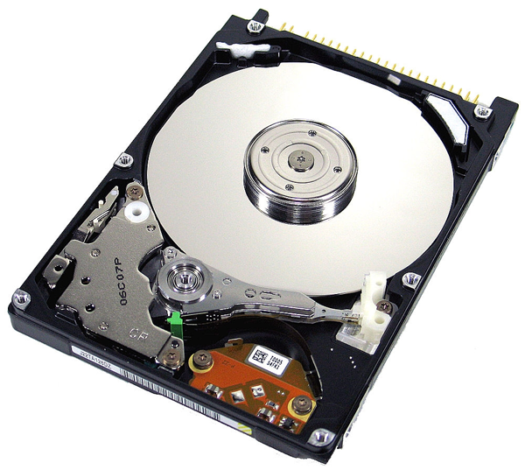
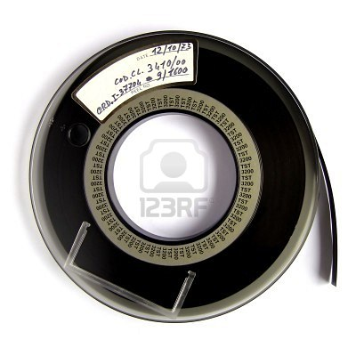
Main limit: Diszk = szalag = 

Slide 21
Jim Gray’s laws
To solve the serialization problem
Scale-out
Processing the exponentially growing amount of data is only possible by parallelizing computation and I/O
Move computation to the data
Instead of copying the data to compute nodes, take computation to the storage nodes with high I/O

Slide 22
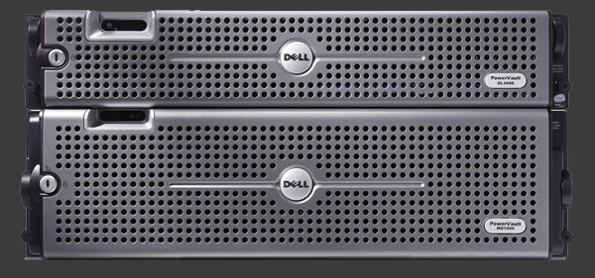

RDBMS: scale-up

Slide 23
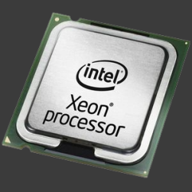
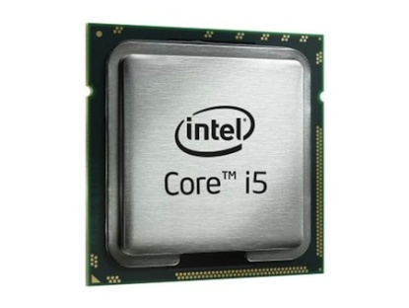
RDBMS: scale-out

Slide 24
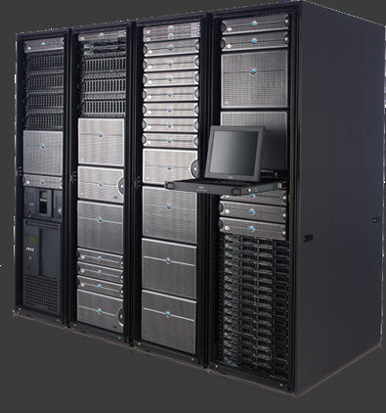
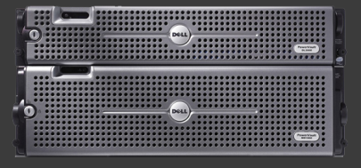
RDBMS: scale-out

Slide 25
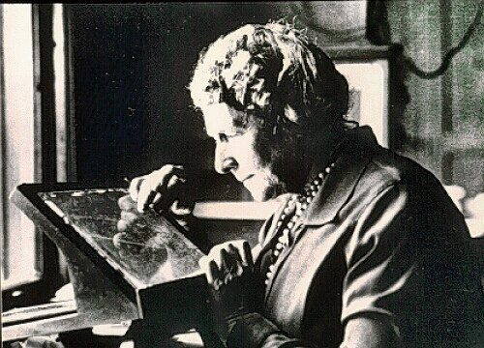
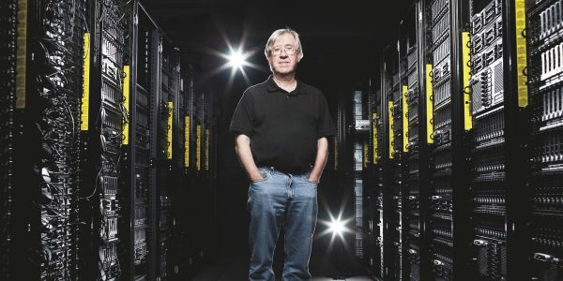

Slide 26
Big Data: The 3 Vs
Volume
Huge data volumes make the optimization of data storage systems very important
Fast, parallel access to the data with sequential read
Velocity
Data come in very fast
Pre-processing, filtering, data reduction as data come in
Streaming algorithms
Variability
If data come from many sources
Endless variance in data formats, heuristinc conversion
Further Vs:
Veracity… etc.

Slide 27
Relational Database Managements Systems
Optimized disk access
Declarative programming
Ad-hoc query support
User-defined functions
Problem: interpreted

Slide 28
Scientific databases
Exponential growth or hardware
-> exponential size of scientific data
Data fit on the huge disks of today but
Disks are slow
Network is slow
Algorithms are slow

Slide 29
Scientific data
Data on all scales: MB -> PB
Multidimensional
Geographically distributed
Slow network
Take computation to the data, not the data to the CPU
Heavy parallelization is necessary

Slide 30
Scientific data warehouses
Must support
Parallelization
Taking computation to the data
Communication among data centers

Slide 31
3. Amdahl’s laws
The necessity to parallelize

Slide 32
Necessity to parallelize
Algorithms more complex than o(N log N) are basically untractable
Computational problems
Only sequential solution
reading from the disk, network
Easy to parallelize algorithms
Hard to parallelize algorithms

Slide 33
Parallelizable problems
1 = P + S
S: sequential part
Can only be done sequentially, no room for parallelization
Takes a long time
P: parallelizable part
We consider it embarrasingly parallelizable
Do same computation on small data
Often no synchronization required
SIMD processing model
When computed in parallel, virtually takes no time compared to S

Slide 34
Amdahl’s law of acceleration
N: number of parallel threads
If N -> inf, speed up = 1/S
Maximal acceleration is determined by the strictly sequential part of the problem

Slide 35
Example
Single disk system
Disk system with 1 GB/s throughput
Many machines with DAS

Slide 36
Amdahl number
How many CPU instructions are needed to process one bit of data
The larger A the better for data processing

Slide 37
Typical Amdahl numbers
Typical server with 4 disks in JBOD
4 × 150 MB/s = 4.8 Gb / s
8 × 2.5 GHz = 20 G.inst/s
A = 0.24
Compute cluster: Blue Gene: A = 0.013
Beowulf: A = 0.08
Cloud VM: A = 0.08
Desktop PC: A = 0.2
Graywulf: A = 0.5
Atom+Ion+SSD: A = 1.25

Slide 38
4. High performance x64-based hardware
Building data warehouses from commodity servers

Slide 39
x64-based server architectures
x64 processor line
8-12-16 core per chip
Multi-level cache
Parallelization
GPUs
Storage systems
Disk, SSD
Raids, distributed file systems
Disk cache
Data bus
Network
Local (ethernet, infiniband, etc.)
Dedicated WAN
Internet
Compute clusters, clouds, database clusters

Slide 40
Multi-CPU architectures
Multi-core:
Single chip, multiple compute cores
Cores are physically close (mm)
Compute cores share same cache
On-chip cache access synchronized from hardware
Multi-CPU
On separate, usually multi-core, chips
Sockets are physically far (cm)
Symmetric multiprocessing
Main memory can be shared or CPU-attached

Slide 41
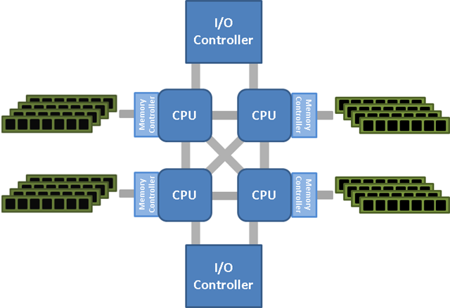
Non-Uniform Memory Access (NUMA)
Memory controller built onto the CPU chip
Multi-CPU systems
Memory is attached to CPU directly
Multiple memory controllers
How to access memory attached to another CPU?
Inter-CPU communication
Intel QPI (quick path IO)
AMD HyperTransport
Image: vmfootprints.org

Slide 42
Cache
Fast CPU
Data in registers can be processed in a single cycle
Slow memory
Throughput might be large but
First byte arrives slow -> latency
Starving: the CPU could work but there is no data to work on
Cache: fast memory between main memory and CPU
Often used memory pages are stored in cache
Hide latency of memory access

Slide 43
Cache variations
Between CPU and main memory
o(10 MB)
can have multiple levels
RAID systems
o(1 GB)
often non-volatile
Disk drive cache
o(10 MB), typically 16-64 MB
Hide latency of head movement during random access
Between storage system and CPU
Often called the „system cache”
Part of the main memory is used
Software solution
Need to write back changes to the disk

Slide 44
Cache internals
Caching is done by pages of 4-64 kB
Always read full page into cache when needed
Data can be modified
When to write changes back to cached memory?
Cache is much smaller than the cached memory
When to flush old pages?
Cache can be used by multiple CPU-s
Multiple caches can cache same data
How to synchronize changes

Slide 45
Cache flush policy
Mark last access time for each cached page
Flush page when
Reading a new page while cache is already full
Flush oldest cached page

Slide 46
Cache write policy
Write-back policy
Make changes to the cache only
Write-back to cached memory before flushing
Write-back policy problem
Cache is volatile, caching non-volatile memory (disk)
Changes are made to the cache only
If system goes down, changes are lost
Write through policy
Changes are written immediately to non-volatile memory
Cannot hide write latency
Making changes is much slower than reading from cache
Write policy can be changed when needed

Slide 47
Snoop filter
CPU 1
L3
cache
RAM
Core 1
L1 cache
L2 cache
Core 2
L1 cache
CPU 2
Core 1
L1 cache
L2 cache
Core 2
L1 cache
Snoop filter

Slide 48
Parallel processing architectures
SISD: single instruction, single data
Single-CPU systems
MIMD: multiple instruction, multiple data
Multi-CPU systems
SIMD: single instruction, multiple data
Many compute cores execute the same program in sync
Process different data

Slide 49
Graphics processors
Originally only for calculating 3D scenes for games
Many parallel processing units
Same program executed on different data in parallel
GPGPU: general purpose GPU
Requires special software
Cuda, OpenCL etc.
There exist scientific software libraries
Convergence with CPUs
CPUs have more and more cores
GPUs have more complex instructions

Slide 50
x64 system bus
PCI-e (Peripheral Component Interconnect Express)
Serial bus with ×1 ×2 ×4 ×8 ×16 lanes
At most 16 GB/s transfer rate
Typical extension cards in servers
RAID controllers
Network controllers
GPU cards
DSP cards

Slide 51
5. Storage systems
Optimizing for space, performance, durability and availability

Slide 52
Storage systems glossary
On-line: always available
Spinning disks, always attached
Off-line: requires human interaction
e.g. magnetic tapes, optical disks, etc.
Sequential: access in the order of physical storage
Random: access in arbitrary order

Slide 53
DAS: directly attached storage
IO controller attached directly to system bus (PCI-e)
Fast but only small distance
Physical space in rack limits storage capacity

Slide 54
NAS: network attached storage
IO system is accessed via network
Longer distance
Smaller throughput, larger latency
Storage capacity is limited by space in data center

Slide 55
Data storage units
Hard disks
Solid State Drives (SSD)
Dynamic memory (DRAM)
Tape devices
Optical storage

Slide 56
Dynamic RAM
Fastest random access to data
Expensive
Volatile
High power consumption (heat!)

Slide 57
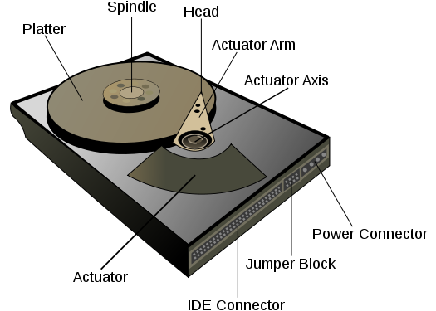
Hard disks
Method of data storage
Information encoded into magnetization of ferromagnetic layer on the disk surface
Read-out leverages GMR technology
Main components
Multiple disks on same spindle
Motor
Read/write heads on single axis
Electronics board
Source: Wikipedia

Slide 58
Hard disks
Mass-produced, cheap
Fast sequential data access – o(150 MB/s)
Random access possible but slow
Need to reposition head
Sensitive mechanics
Spinning disks, precise heads
Bearing
Life time limited by wear on mechanical parts
Storage capacity limited by
magnetic data density
disk rotation speed
read-out electronics bandwidth
High power consumption – o(15 W)

Slide 59
Main parameters of disks
Physical size
2.5” or 3.5”
Typically 2-3 disks per drive
Capacity: 200 GB – 8 TB
Current technology up to 32 TB
Shingled recording …
Speed
60-150 MB/s sequential (edge of disk)
4.5-15 ms random access time
Limiting factor: revolutions per minute (5400-15000 rpm)
Disk cache
16-32-64-128 MB
Enterprise grade disks
Intended for server use
Better mechanical construction
Vibration tolerance
Bigger cache
Firmware designed for RAID
3× price tag

Slide 60
Disk = tape = 
Dynamic memory:
Fast, small, expensive
Disk: cheap but slow
100-150 MB/s
Very high random access latency
Reading a 1 TB disk
sequentially: 4,5 óra
Random access: 15-150 nap
DATA ≫ MEMORY
DISK RANDOM IO 
SEQUENTIAL IO
SSD ?

Slide 61
Failure of disks 1.
Controller board
All of data unavailable
Replacing board might fix unit (relatively easy fix)
Physical damage of disk
Usully point errors
Controller logic can automatically fix point errors
Extra space is kept for this purpose
Extra space runs out if disk fails repeatedly
Bit rotting
Magnetic domains can flip over time
Can be detected from checksums
Requires regular reading of data

Slide 62
Failure of disks
Mechanical damage to moving parts
Motor, bearing, head movement
Replacements is tricy
Only when data loss is more expensive than servicing
S.M.A.R.T.
Self-monitoring, Analysis and Reporting Technology
Information on health and status of disk unit
Operational statistics, temperature, failures, etc.
Estimated life time
Predict catastrophic disk failures before they happen
Can prevent data loss

Slide 63
Solid State Drives
Semiconductors built on silicon
Non-volatile memory, no need to refresh like DRAM
No moving parts
Fast random data access
Still orders of magnitude slower than DRAM!
Writes need to be done in big blocks
Blocks wear out when written too often
Software logic to „rotate” blocks
Life time is limited by write wear
Storage capacity limited by lithographic technology
250 MB – 2 TB
Low power consumptions
Expensive
Long-term reliability is not known

Slide 64
Interfaces and protocols
SATA III: Serial Advanced Technology Attachment
Desktop PCs, laptops
6 Gb/s, 600 MB/s
Max. 1 m distance
One cable per disk
SCSI: Small Computer System Interface
Workstation and small servers
Hardware phased out, protocol reused in SAS
SAS: Serial Attached SCSI
SATA hardware + SCSI protocol
6-12 Gb/s, 1.2 GB/s
Max. 10 m distance
Multiplexers, backplanes supported
Backward compatibility with SATA disks (large capacity cheap disks)
Fibre Channel:
Optical link to bridge large distances, expensive
2-16 Gb/s
iSCSI: SCSI protocol on top of TCP/IP
Network attached storage

Slide 65
Tape devices
Good price/capacity ratio
Drives are expensive, tapes are cheap
Only sequential data access
Archival storage
Backup storage
Sneakernet
Data transport without networks

Slide 66
Optical devices
Low capacity compared to other technologies
No use in big data environments

Slide 67
6. Redundant disk systems
How to bridge the gap between disk failure and durability

Slide 68
Problems
Individual disks
Read/write throughput is not so good
probability of a single disk failure is high
Need larger volumes than 2-8 TB
We want
Redundancy to achieve high availability and durability
High I/O throughput
Large storage capacity
-> Need to combine multiple disks
Hardware solution: RAID
Software solution: redundant volumes and file systems

Slide 69
Glossary
Physical disk
RAID
JBOD
Virtual disk
Volume
Volume Manager
Partition
File System
Block size
Slab size
Parity bit
Distributed parity
Hot-swap
Hot-spare
SATA
SAS
SCSI

Slide 70
RAID
Redundant Array of Identical Drives
Multiple (usually identical) disks combined into one unit
Operating system sees it as a single large volume
Goals
Faster data access
Redundancy: survive physical disk failure
Larger capacity

Slide 71
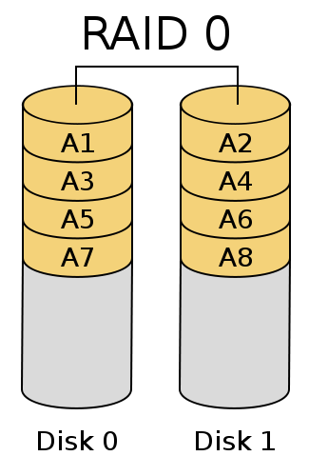
RAID – faster data access
Factors limiting single disk throughput
RPM of disk
Bit density
Read/write multiple disks in parallel
Data is striped
Striped distributed among disks
Sequential access is across disks
Parallel access multiplies throughput
Throughput proportional to number of spindles
Factors limiting multi-disk throughput
Throughput of disk controller typically 2 GB/s
Number of attachable disks

Slide 72
RAID - redundancy
Failure of one (or more) physical disk(s) must not bring entire volume down
Data needs to be stored redundantly
Full duplication (mirroring), or
Store parity bits
More redundancy, less net disk capacity
Duplicated data, parity bits take up additional space
Maximal size of hardware RAID volume is determined by the smallest disk of the array

Slide 73
RAID configurations: RAID 0
Striping for higher throughput
Data distributed such a way that sequential read is done across disks, in parallel
Total capacity: C_{total} = n_{disk} × C_{disk}
No redundancy! p_{failure} = n_{disk} × p_{failure,disk}

Slide 74
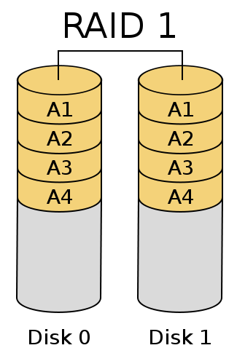
RAID configurations: RAID 1
Mirroring for redundancy
Data copied to two or more disks
Survives failure of one of the mirrors
Total capacity: C_{total} = n_{disk} × C_{disk} / 2
Redundancy: p_{failure} = (homework)

Slide 75
Parity bits
Disk 1: 10011101
Disk 2: 11001001
XOR: 01010100
Stored on Disk 3
Recovery in case of a failure
Disk 1: 10011101
Disk 2: 01010100
XOR: 11001001
This is what was on Disk 2!
Generalization to n disks: Even or odd number of 1-bits out of n
Can survive the failure of a single disk
We cannot tell the failing disk from the parity only, need additional info
Can be generalized to survive the failure of more than one disks

Slide 76
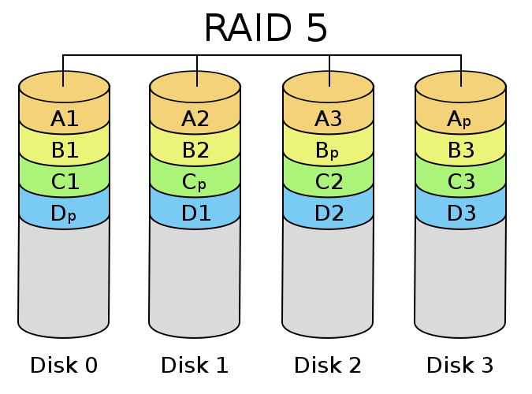
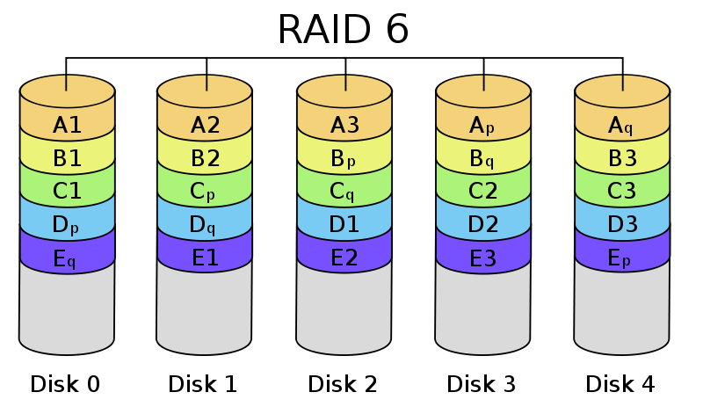
RAID configurations: RAID 5/6
RAID-5:
Minimum three disks
Parity bits distributed across disks
Survives failure of one disk
RAID-6:
Minimum four disks
Double parity, on two disks
Survives loss of two disks

Slide 77
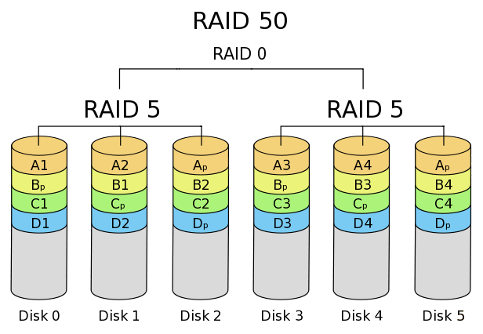
RAID kconfigurations: RAID n+0
Combine striping with redundancy
Striping of two raid volumes
Minimum four disks (1+0)
Only faster when reading
Need to write both disks during write
Total capacity: C_{total} = C_{RAIDn} / 2
Redundancy: p_{failure} = (homework)

Slide 78
Writing RAID
Need to write multiple disks at once
Wait for all disks to rotate to right position
Average rotation time: <r> = 1 – 2^{–n}
Γ = revolutions per minute
<l> = average latency: <l> = <r> / Γ
Typical values:
Γ = 7200 RPM, <l> = 4.2 ms
In case of multiple disks, until all disks turn to the required position: <r> = 1 – 2^{–n}
SSD: 0 latency, big potential in the near future
Number of disks | Average latency (in terms of revolution)
1 | 0.500
2 | 0.750
3 | 0.875
4 | 0.938
5 | 0.969
6 | 0.984
7 | 0.992
8 | 0.996

Slide 79
Reducing RAID write latency
Can save two read operation when data is in cache
Use write-back cache
Write to the cache only
Wait with writing to the disk until cache page is flushed
Write when the IO system is idle
Does not work with long writes where cache is small compared to data size

Slide 80
RAID write hole
Writing multiple disks is not atomic operation
What if something goes wrong during write?
Disk drive fails
Power loss
Avoid power loss
Redundant, uninterruptible power supply
If cache is volatile RAM, use battery to power RAM
BBU = battery backup unit

Slide 81
RAID systems for databases
Scientific data warehouses
Reading is much more frequent than writing
Long sequential operations
RAID 5 for large capacity and high availability
Use write-through cache during data loading
Transaction processing systems
Many tiny writes
RAID 1+0 for higher throughput
Use write-back cache

Slide 82
RAID operations: volume rebuild
Failing disk causes volume to be in degraded mode
Replace disk manually
Start rebuild
Volume rebuild can take many hours, depending on disk size
What if another disk fails during rebuild?
RAID controllers support hot-spares
Start rebuild on hot-spare as soon as failure detected

Slide 83
RAID operations: patrol reads
Bit rotting: silent data corruption
Need to read data in order to learn about error
Schedule regular reads to find bit rotting
Do when system is idle
Patrol reads or scrubbing

Slide 84
Software RAID
Parity calculation on the CPU
Cheap solution for workstations, small servers
RAID 5,6 etc. Are very slow
No dedicated, non-volatile or battery backed cache
OS sees individual disks
Volume manager concatenates disks into one virtual volume

Slide 85
Hardware RAID
Dedicated RAID controller card
Parity is computed by IO processor
Often expensive
Fast RAID 5 and 6
Ability to optimize on hardware level
To reduce latency
Large, non-volatile or battery-backed cache (1-2 GB)
Adaptive prefetching
OS sees one large, continuous volume

Slide 86
Typical RAID problems 1
Gives a false sense of security
Good for high availability, not enough for redundancy
Slow volume rebuild
Another disk failing during rebuild leads to total data loss
Big problem with many disks
RAID 6 reduces risk significantly
Correlated disk failures
Disks purchesed together are from the same manufacturing batch
Problems arise with many disks at the same time
Second disk fails during rebuild when load is heavier

Slide 87
Typical RAID problems 2
RAID controller error (non-mechanical, rare)
Usually leads to total data loss
Card cannot always be replaces (old model)
Data format on disk is specific to RAID card vendor
RAW data recovery might require special software
Lack of compatible disks
Disk models are retired quickly
Old RAID cards might not work with newer disks
Better to replace entire RAID volume

Slide 88
Typical RAID problems 3
Lack of battery backup unit
When policy is set to write back
Write operations are reported complete by RAID card
Data is still in the cache only
System crashes -> data loss
Too many disks in a RAID
Requires large chassis and power supply
RAID extension modules: too many cables
Multiplexed backplaned and bundled cables
Frequent disk failures require manual disk replacement
Servers cannot be stopped
Hot-swap functionality

Slide 89
Components of a RAID system
Usually SAS
SBB: storage bridge bay
Open standard
SAS controller (w/ RAID)
4 × SAS links
Multiplexer backplane
RAID extension boxes
Server
PCI-e
RAID controller
4×SAS
4×SAS
Backplane + Multiplexer
SATA/SAS
SATA/SAS
SATA/SAS
SATA/SAS
SATA/SAS
SATA/SAS
SATA/SAS
SATA/SAS
Disk
Disk
Disk
Disk
Disk
Disk
Disk
Disk

Slide 90
RAID system with internal disks
Server chassis
Internal RAID card
Disk drive
Disk drive
Disk drive
Disk drive
Disk drive
Disk drive
Disk drive
Disk drive
SATA / SAS
PCI-e
Motherboard

Slide 91
RAID with extension box
Server chassis
RAID card w/ external ports
4× SAS
PCI-e
Motherboard
RAID chassis
Disk
Disk
Disk
Disk
Disk
Disk
Disk
Disk
Enclosure Management Module (EMM)
SATA/SAS Backplane

Slide 92
7. Storage system software layers

Slide 93
Software layers
Database Server
File Server
Web Server
File API
FS
FS
File System
Partition
Partition
Volume
Physical or virtual (HW RAID) disk
Physical or virtual (HW RAID) disk
Physical or virtual (HW RAID) disk

Slide 94
Glossary
Logical volume
Software solution to bundle multiple disks
Software raid or redundant volume
Partition
A single physical or logical volume can be split into multiple partitions
Multiple file systems per volume
File System
Logical layout of directories and files on the disk
Over partitions or volumes
FAT32, ext4, NTFS, zfs, etc.
File API
Function library to handle the entire storage stack
Unifies variations in software/hardware to give abtract, unified view of file access to the programmer

Slide 95
Redundant volumes
Hardware RAID
Expensive, not flexible enough
Software RAID
Cheap imitation of hardware RAID
Slow
Software solutions to replace raids?
zvol (Sun, since 2005)
Storage Spaces (Windows)
Modern file system on top of redundant volumes
ZFS – Solaris, Linux
BTRFS – Linux
ReFS – Windows 2012 Server
Tree-based file system
Not for databases

Slide 96
Redundant volumes
Fundamental unit: slab
Instead of small blocks (64 kB) use large slabs (128 MB)
Mirrored or parity bits stored
Support extraordinary volume sizes (zettabyte 10²¹)
File system provisioning
File system size is not set at initialization
Add disks later when more space is needed
Do not require volume rebuild
Smallest disk’s size is no longer a limitation
Scrubbing
Detect disk error by background patrol process

Slide 97
Redundant volumes
Redundant volumes are software solution
No dedicated non-volatile memory for cache
Use of SSDs is supported
Also: NVMe drives, Xpoint devices
Distributed volumes
Across servers
Multiple copies
Higher availability
Complex logic to maintain consistency among replicas

Slide 98
Distributed redundant volumes
GPFS (IBM)
Lustre
Gluster
Storage Spaces Cluster

Slide 99
File API: buffering
Buffered
When reading from the disks, data arrives into an intermediate buffer first
Need to copy necessary memory to program space
Read arbitrary number of bytes at arbitrary position
Unbuffered
Read disk directly into program memory space
Only multiples of block size (512 B, 4 kB)
Only block-aligned
Much faster than buffered IO

Slide 100
File API: async
Synchronous operations
Program thread blocked until data arrive
Affected by IO system latency
Asynchronous operations
Program thread begins IO operation then proceeds
Call back function is called when data arrive
Multiple IO jobs are possible in parallel
Outstanding IO jobs
Many disk controllers support a long IO operation queue
Controller can optimize by reordering operations
Need to fill queue as much as possible for good performance
Requires async file API

Slide 101
8. Benchmarking
Measuring IO performance

Slide 102
Measuring IO performance
Why do we measure?
Choose between vendors
Determine optimal settings of existing hardware
Given the constraints of the use-case (read heavy, write heavy, etc.)
Need to define exactly
The test load used for benchmarking
The method of measurement
Need to know future use of the system, but in case of data warehouses, we generally go for sequential IO

Slide 103
What do want to optimize?
Number, size and speed of disks
More disks -> more spindles -> faster
Faster disks (10k RPM 2.5”)
RAID level
How much redundancy we need
How much we want to write
Multiple RAID volumes can be configured for the same server
For cold data, temporary data etc.
RAID cache policy can be changed during operation
Use write-back when not much data is written, etc.
Size of stripes
Adjust to the page size of the database (see later, typically 64 kB)

Slide 104

What can we measure?
Throughput [MB/s]
Latency [s]
I/O operations [1/s]
CPU use
Outstanding I/O jobs
Parameters
Read or write
Sequential / random
Buffered/unbuffered
Cold/Hot buffer
Read/write block size
Stripe size
Outstanding jobs
Typical test load
Combination of the above

Slide 105
Measurement method
Flush buffers if necessary
Repeat measurements
Evaluate distribution of results
Is it Gaussian?
Is it something else? Why?
Does it correlate with something?

Slide 106
9. Networks
Very briefly

Slide 107
Network physical layer
Medium type
Optical
Long distance, low noise, high bandwidth
Used in core networks between datacenters
Copper
Short distance, medium bandwidth
Used in local networks
Wireless
Used in data collection systems
Bandwidth
1g, 10g…
Latency
Topology
Routed, switched

Slide 108
Network software layers
Operating system network stack
Network card driver
Software protocol layer
Most often TCP/IP
Network API
Programming interface to network stack
Typical optimized OS support
File copy over network
Database Server’s own protocol optimized for networking

Slide 109
Local network
Ethernet
1 Gb/s, 10 Gb/s
Copper UTP cabel
o(10 m)
Most often TCP/IP
Switched / routed
InifiniBand
At most 96 Gb/s
Max 15 m distance
Own software stack
TCP over IB
Switched

Slide 110
Internet connection
Almost always much slower than local network
TCP/IP with it’s own limitations
Network latency affects TCP transport badly
Special protocols to hide latency
UDT
based on UDP, hides network latency by async messaging
large software buffers and adaptive flow control
FDT
Developed at CERN, written in Java, cross platform
Multi-tread transfer to hide latency
Unbuffered IO to disk for best performance
BitTorrent
Fast even between only two peers
Hashing large files takes forever

Slide 111
Dedicated network
Guaranteed bandwidth long distance link
Usually very expensive
Hard to utilize optimally
Often can use own protocol (not limited to TCP/IP)
Software defined networks
Configure virtual dedicated network on-demand
Uses existing infrastructure
Share hardware, still have dedicated bandwitdth and low latency

Slide 112
Problems with TCP/IP
Designed for low speed and small data
Bandwidth is not equal to throughput
Latency can degrade performance
TCP uses handshaking
Sender has to wait for acknowledgement
Roundtrip time can be 100+ ms across the Atlantic
Large buffer can increase net througput
Avoid handshakes (UDT)
Use parallel transfer threads
Error correction code is weak
Can fail easily when transfering terabytes of data
Database servers don’t always support special protocols
TCP/IP is still widely used in data centers

Slide 113
Traditional clusters and clouds
Typical compute cluster (HPC, beowulf)
Almost identical hardware
Nodes optimized for CPU, no IO system
Centralized storage available over network only
Often blade servers
High performance local network, MPI
Compute cloud
Loose array of host machines serving virtual machines
Users access virtual machines only
VM image customized for every user
5% overhead from virtualization
Virtual network among VM nodes
Centralized storage, available over network only

Slide 114
Data intensive cloud
Data is already somewhere
Servers with optimized IO system and network
Move computation to the data, not the data to the CPU!
SQL databases
Formulate data analysis in SQL language
queries run on remote server
Virtual Machines, Docker containers
Move any computation next to the data
Ipython notebooks
Run in docker containers
Lightweight virtualization and direct access to the data

Slide 115
Power consumption
Typical power consumption of components
Base system: 50-100 W
CPU: 80-150 W each
HDD: 15 W each
SSD: 1-2 W each
GPU: 50-150 W each
Typical storage server: 1.2 – 2 kW each
Dissipated as heat

Slide 116
Further problems
Cooling system
Power consumption equal to servers
Noisy, server room requires acoustic isolation
Possible cooling solutions
Liquid cooling
Use cooling water for heating in winter
Green servers
Environmental impact
Typical server life span: 5 years
After this a computer is hazardous waste
Abundant in rare materials
Batteries

Slide 117
10. Databases
Relational Database Management Systems

Slide 118
Database Server
Dedicated Server for databases
Optimized storage, IO, network configuration
Single purpose
Only operating system + database
Database server manages entire memory
Single purpose -> virtual host
User processes in VM or docker
Move complex computations to database nodes

Slide 119
Database server main operations
Organized data storage in non-volatile memory
Data are indexed
Execute queries
Optimize memory, IO and CPU during query execution
Data modification
Transaction processing
Long-running, concurrent execution of atomic operations
Maintain data consistency
Durable storage of data
Must survive partial system crash

Slide 120
Relational Database Management Systems (RDBMS)
Originally for business applications
Relational data model
Tables, indices, joins
Data-oriented declarative language: SQL
Structured Query Language
Main product lines
Open source: MySQL, Postgres
Oracle
Microsoft SQL Server
IBM DB2
SAP HANA
SyBase etc.

Slide 121
SQL
DATABASE
TABLE
VIEW
SELECT
TOP
FROM
INNER JOIN
CROSS JOIN
WHERE
GROUP BY
HAVING
ORDER BY
INSERT, UPDATE, DELETE
OUTER JOIN
UNION, EXCEPT
STORED PROCEDURE
INDEX
CLUSTERED INDEX
READ UNCOMMITED
SERIALIZABLE
CURSOR
FUNCTION
CROSS APPLY
FILE GROUP
PARTITION FUNCTION
JOIN HINT

Slide 122
Relational Data Model
Set
One column of a table
Tuple of columns
Operations
Cartesian product
Selection
Projection
Union, difference
Schema
Constraints on which Cartesian products of the sets in what order can be taken
Relation
Subset of a Cartesian product

Slide 123
Relational algebra: tables with schema
 | LastName
1 | Kovács
2 | Szabó
 | FirstName
1 | Géza
2 | Béla
 | Age
1 | 42
2 | 57
Cartesian product
Selection
R1 | LastName | FirstName | Age
1 | Kovács | Géza | 42
2 | Szabó | Béla | 57
Projection
Relation
R2 | LastName | FirstName
1 | Kovács | Géza
2 | Szabó | Béla

Slide 124
Relational algebra: product of tables
ID | LastName | FirstName | Age
1 | Kovács | Géza | 42
2 | Szabó | Béla | 57
ID | Author | Title
1 | 1 | Könyv 1
2 | 1 | Könyv 2
3 | 2 | Könyv 3
LastName | FirstName | Title
Kovács | Géza | Könyv 1
Kovács | Géza | Könyv 2
Szabó | Béla | Könyv 3

Slide 125
Tables
Authors
ID | LastName | FirstName | Age
1 | Kovács | Géza | 42
2 | Szabó | Béla | 57
Table is the fundamental data storage entity of a database
Predefined set of columns
Any number of rows
Column
Name
Data type: number, text, etc.
Variable/fix length for text
Constrains: unique, interval, auto increment etc.
Row
Any number of rows in each table
Same data structure for each row

Slide 126
Contraints
Primary Key
Unique identifier within a single table
Single column or combination of columns
Foreign Key
A value in a column point to an ID in another table
Authors
ID | LastName | FirstName | Age
1 | Kovács | Géza | 42
2 | Szabó | Béla | 57
Books
ID | Author | Title
1 | 1 | Könyv 1
2 | 1 | Könyv 2
3 | 2 | Könyv 3

Slide 127

Primary key, foreign key
Emberek
 | ID | int
 | Vezetéknév | nchar(50)
 | Keresztnév | nchar(50)
Könyvek
 | ID | int
 | SzerzőID | int
 | Cím | nchar(250)

Slide 128
11. Pysical Storage Schemes
Physical layout of data in database servers

Slide 129
Fundamental problems of databases
Data is much bigger than the main memory
Non-volatile storage is always much slower than the main memory and the CPU
Sequential disk access is much faster than random
Store data in order, indexed
Data processing algorithms
Optimize for sequential data access
Optimize memory for size, access pattern and NUMA
Fast or no transformation between in-memory and disk data formats

Slide 130
Physical data storage in SQL servers
Importance
Understanding physical layout of data is important
How to configure underlying hardware
Significant increase in performance vs. naive approach
Row-oriented data storage
Original, older technology
Typical solution for SQL systems for transaction processing
Column-oriented data storage
Newer technology
Better performance for data that don’t change
Data warehouses, data mining
Array databases, point clouds

Slide 131
Units of physical data organization
Database: a collection of file groups
File group: a collection of data files
Data file
a physical file on one of the file systems
determines which part of the hardware is used
Extent: a collection of data pages
Data page: an 8 kB block of data (rows)
Transaction log: see later

Slide 132
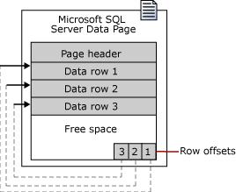
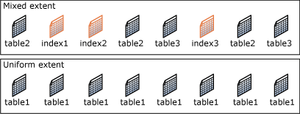
Database pages
Unit of data storage
Fixed size: 8 kB
8 pages = 1 extent (64 kB)
Read/write full extents only
Same data format on disk and in memory
Various page types
Data
Index, etc. (see later)

Slide 133
Logical data storage in SQL servers
Tables are collections of data rows
Table defines row format
Data types
Fixed size: int, bigint, real, float, char(20), binary(250) etc.
Variable size: varchar(50), varbinary(250) etc.
BLOB (binary large object) text, ntext, varbinary(max), image etc. 2 GB maximum

Slide 134
Special data pages
Page size 8 kB
Useful to store data: 8000 bytes
So called in-page data
Rest is header, footer, pointers etc.
Row overflow page
Store data that doesn’t fit into 8000 bytes
Out-of-page data
Significantly slower access than in-page
BLOB page to store long text or binary data
Every row stored as and individual B-tree
Faster seek, slower scan than ordinary files

Slide 135
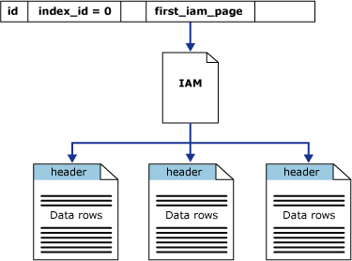
Heap tables
Non-ordered table
Rows are stored in undetermined order
Usually in the order of data ingestion
Rows stored continuously on data pages
List of pages + pointers to next/prev page
Disadvantage: Have to read whole table during search
Advantages
Inserts are simple, append to the very last page
Good for quickly loading lots of data

Slide 136
Primary key
A single column or combination of columns
Must be unique in the entire table
Well-defined ordering
Multi-column: lexicographical ordering
Specify order direction for each column independently
Any two keys should be comparable: < or >
Simplest key: incrementally generated integer ID

Slide 137
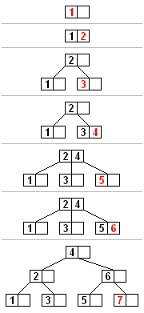
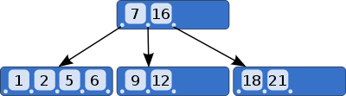
B-tree and B+-tree
Data structure to store ordered data
Nodes: d data rows, d + 1 pointers
Pointers point to additional rows
When nodes are full, we split them into two
Tree traversal using recursive algorithms
Finding an item by key: o(log_{d} n)
Tree can be scanned according to the ordering defined by the key (or in reverse order)
Database servers: B+-tree
only store keys in intermediate nodes
Leaf nodes store actual data

Slide 138
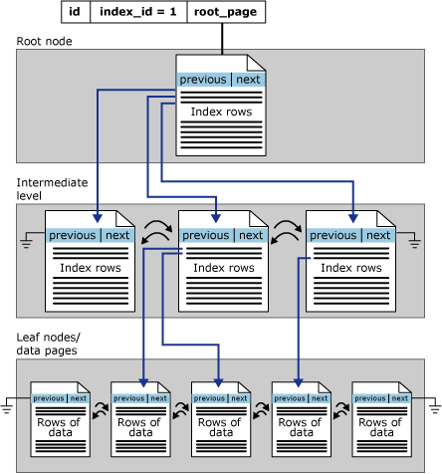
Table with clustered index
Table stored as a B+-tree
Tree node = data page
Two page types
Index page
Leaf node page storing rows
Pointers to prev/next page
Support sequential scan

Slide 139
Advantage of clustered index
Find row by key in n log n time
SELECT * FROM t WHERE ID = 12
Scan ID range very quickly
SELECT * FROM t WHERE ID BETWEEN 12 AND 36
Read table in the order of the key (or in reverse) Doesn’t require re-sorting!
SELECT * FROM t ORDER BY ID

Slide 140
File groups and table layout
Collection of multiple files
Files can be different size
On different disks
Parallelization over multiple RAID cards
Tables and indices mapped to file groups
Can span multiple files
Pages in files allocated evenly
Tables can span RAID cards
File groups can contain many tables, indices
Pages from different tables can mix
Can lead to degraded performance
Optimal case
Pages of a single table in sequential order
No out-of-page columns
BLOBs in separate file group
Indices in separate file group

Slide 141
Control over location of data
Database administrator can define location of database files
Where in file system
Determines the hardware to be used
Certain files can go to faster/slower storage
Size of files predefined or auto-grow
Data tables are mapped to file groups
Can be across files
Across raid volumes
Automatic parallel IO with more than one RAID cards

Slide 142
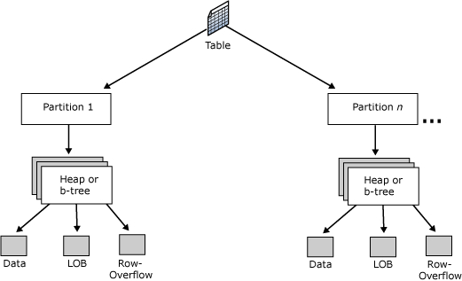
Partitioned tables
Table partitioned by defining non-overlapping intervals of the primary key
Intervals = partitions
Partitions mapped to different file groups
Partition can be switched in and out
Important during data loading
Minimal impact on query performance

Slide 143
12. Indices
Logarithmic-time access to data

Slide 144
Non-clustered indices
A table can have only one clustered index
Determines the storage order for the entire table
Search and sort only by the primary key
Non-clustered index
What if we want to search by other columns?
Additional data structure next to the table
Built on one or more columns with given ordering
Contains only indexed columns
Pointers to data pages of the clustered index
Can be unique
Can implicitly contain non-indexed columns

Slide 145
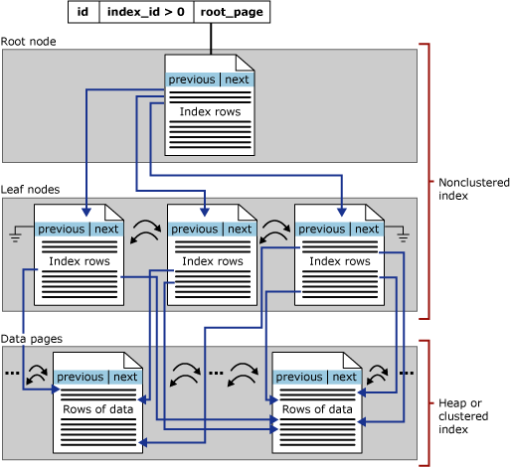
Non clustered index storage
Clustered index
Non-clustered index

Slide 146
Included columns
Indexes store only indexed columns by default
Pointers to clustered index leaf pages
If querying indexed columns only, it is enough to scan index pages only
If additional columns are needed: random reads from clustered index
Included columns
Store additional columns next to pointers
No need to go to clustered index when column is needed

Slide 147
Properties of indices
Advantages
Fast search by the indexed columns
If multiple columns, lexicographical ordering
Must always set constraint on most significant columns
Read data sequentially in indexed order (or reverese)
Disadvantages
Requires more storage, indexed columns stored twice
Data modification (insert, update, delete) requires updating the index
Significant performance hit if data change often

Slide 148
Insert data into indexed table
Indices stored in B-tree
d key and d + 1 pointer per page
If need to insert the (d + 1)th key: page split
Fill factor
How much a page can be filled initially
Fill factor < 100%
Reserve space for additional rows
Faster insert and no page split is needed
Requires additional disk space
Scanning index takes longer, empty part of pages needs to be read too
Data don’t change often
Set fill factor to 100%

Slide 149
Index statistics
For every clustered and non-clustered index
Computed automatically
Histogram of index keys
Number of row
Number of rows with repeating keys
Helps server choose the right index automatically

Slide 150
Designing indices
To few indices
Less room for query optimization
Most queries will not be optimal
Problems with transactional execution (deadlocks)
Too many indices
Take up a lot of space (might be worth it)
Takes a long time to build them
Write into indexed table is extremely expensive

Slide 151
13. Physical operators
Fundamental physical operators of SQL databases

Slide 152
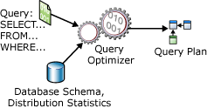
Steps of SQL query processing
Parse
Build query tree
Optimize query
Execute query
Format data

Slide 153
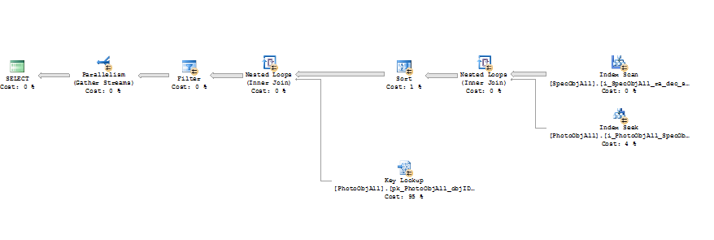
Query plan example
SELECT s.SpecObjID, s.z
FROM PhotoObjAll p
INNER JOIN SpecObjAll s
ON p.SpecObjID = s.SpecObjID
WHERE p.dered_g < 17

Slide 154

Table scan
Heap table without any index
Can be read only sequentially
Have to read entire table
No well-defined ordering
Typical queries
SELECT * FROM t
SELECT * FROM t WHERE a = 2

Slide 155

Sort
Heap table with undefined ordering
Output of another operator with wrong ordering
Typical query
SELECT * FROM t ORDER BY a
Table is not indexed by a
Have to sort rows
Quick sort with storage on disk
Algorithm optimized for large tables, still slow
Sort happens in tempdb
Can be put on fast storage (SSD, NVME)

Slide 156

(Clustered) index scan
Given a table t with an index on column c
Column c contains unique values
Scan range of key intervals
SELECT c FROM t WHERE v BETWEEN 5 AND 10
Order by index keys
SELECT c FROM t ORDER BY c
Index defines an ordering
Different ordering always requires a sort
Clustered index: contains all columns
Non clustered index: only key and included columns
Querying other columns requires a bookmark lookup in clustered index
Results in random reads, slow

Slide 157

(Clustered) index seek
Given a table t with index on column c
Column c contains unique values
Typical query
SELECT c FROM t WHERE c = 12
Finding a single row by ID
Table scan: o(N)
Index seek: o(log(N))
If column c is not unique: index scan instead of seek
Index seek mostly used for
Filtering by key
Joins on foreign keys (see later)

Slide 158

Bookmark (key) lookup
Given a table t with non-clustered index on column c
Query column d which is not part of the index
SELECT d FROM t WHERE c BETWEEN 2 AND 10
Rows found quickly using index on c
Index contains only pointers to the rows
Column d needs to be read from clustered index
Fetch row by primary key or bookmark (heap tables)
Expensive operation, scans result in random IO

Slide 159
Logical join operations
Relational algebra: a join is simply a subset of the Cartesian product of two tables
CROSS JOIN: entire Cartesian product
SELECT * FROM t1 CROSS JOIN t2
INNER JOIN: only rows satisfying join condition
SELECT * FROM t1 INNER JOIN t2 ON f(t1.c1, t2.c2)

Slide 160
Additional logical join types
LEFT(RIGHT) OUTER JOIN
Take all rows from left (right) table
regardless if join condition is not satisfied
Fill non-matches with NULL values
SELECT * FROM t1 LEFT OUTER JOIN t2 ON f(t1.c1, t2.c2)

Slide 161
Additional logical join types
SEMI JOIN
Only check if row exists in other table
SELECT * FROM t1 WHERE t1.c1 IN (SELECT t2.c2 FROM t2)
ANTI JOIN
Returns rows that are not in another table
SELECT * FROM t1 WHERE t1.c1 NOT IN (SELECT t2.c2 FROM t2)
SELECT t1.* FROM t1 LEFT OUTER JOIN t2 ON f(t1.c1, t2.c2) WHERE t2.c2 IS NULL

Slide 162
Additional join types
Range join
If query restricts key not to a unique value but to a range
Filter by interval
SELECT * FROM t1 INNER JOIN t2 t1.ID BETWEEN t2.start AND t2.end
Will be important for hierarchical spatial indices

Slide 163

Nested loop join
Physical join operator
Implements inner or outer joins
Given t1 and t2 with columns c1 and c2
Typical query
SELECT * FROM t1 INNER JOIN t2 ON t1.c1 = t2.c2
Outer loop: scan t1
Inner loop: usually seek t2 by key, sometimes bookmark lookup
If no appropriate index on t2.c2, table t2 is scanned
Leads to bad performance

Slide 164

Merge join
Limited use
Typically one-to-one table matching
Join on primary keys
Keys have same ordering, or smaller table can be ordered quickly on-the-fly
Scan the two tables in the same order
Scan done in parallel, sequentially
Always step scan pointer that’s behind the other

Slide 165
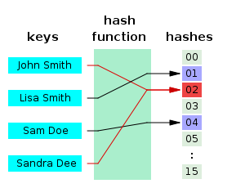
Hash function
h: D → R, where |D|>> |R|
R is usually integer we specify the bit length of R
Not one-to-one mapping: hash collision
Hash function needs to be simple
Fast computation of hash value

Slide 166
Hash table
2^{d} different possible hash values
Hash chains
Allocate 2^{d} pointers – RowT** array
Each pointer points to the beginning of a chained list:
Elements of list all have the same hash value
Lists can contain any number of elements
Finding an element (a row) in a hash table
Calculate hash from columns – o(1)
Find the right hash chain – o(1)
Find row in list – o(N/2^{d})
Telling if a row is not in the table – o(1)

Slide 167
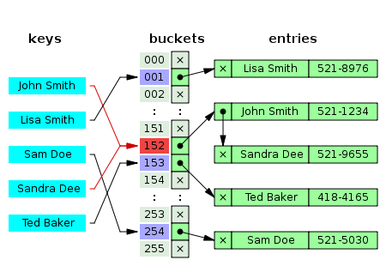
Hash chains

Slide 168

Hash match join
Given table t1 with a key c1
Given relatively small table t2 with no key on c2
Typical query
SELECT t1.c1, t2.c2 FROM t1 INNER JOIN t2 ON t1.c1 = t2.c2
Anti-join queries
Compute hash on values of t2.c2
Build hash table in memory
Spill to disk if not enough memory
Leads to bad performance
Execution of join
Scan t1 by key sequentially
Can tell in o(1) if t1.c1 is not in hash table
Otherwise traverse hash chain, find appropriate row

Slide 169


Summary of table read operators
 | Table scan | Scans a heap table sequentially. Multiple parallel scans can run in parallel
 | Clustered index scan | Equivalent of table scane if the table has a clustered index. Reads all rows or range of rows defined by an interval of keys.
 | Clustered index seek | Reads individual rows identified by the key of clustered index.
 | Nonclustered index scan | Sequentially scans the entire table or a range, ordered by the key of the index. All required columns must be included in the index, otherwise performance is degraded by bookmark lookups.
 | Nonclustered index seek | Reads individual rows identified by the key of the index.

Slide 170
Summary of join operators
 | Merge join | Any logical join operation between two tables or indices with same ordering of key columns.
 | Nested loops | If tables or indices are not ordered appropriately. If a non-included column is required, with bookmark lookup in inner loop.
 | Hash match | Build a hash table from the smaller table, match by finding keys of other table in hash table.

Slide 171
Aggregates
COUNT(*), MIN, MAX, AVG, SUM, STDEV
GROUP BY, HAVING
User-defined aggregates
Have to implement three functions
Accumulate: process next row
Merge: merge results from two threads
Terminate: calculate final result
Aggregates must be computable with this simple model

Slide 172
An example: averaging
void Accumulate(avgstate a, double v) { a.count ++; a.v += v; }
void Merge(avgstate a, avgstate b) { a.count += b.count; a.v += b.v; }
double Terminate(avgstate a) { return a.v / a.count; }

Slide 173
Group by operations
Hash match
If the table is small enough
Use hash match for aggregation
Hash table stores status of each aggregate group
Stream aggregate
Read table in the order of GROUP BY clause
Requires an appropriate index
Rows can be aggregated sequentially
No need to keep more than one aggregate group in memory

Slide 174
14. Query optimization

Slide 175
The query optimization problem
SQL language is declarative
We specify what we want in the results
Not how we want the results to be computed
Information available to the server
The SQL query itself (WHERE, JOIN, GROUP BY, ORDER BY)
Database schema: tables, columns, keys, storage model
Non-clustered and clustered indices
Index statistics (histogram of key distribution)
Available memory, number of CPUs
Server implements numerous phyisical operators
SQL query can be processed many ways
Server enumerates possible query plans solving the same problem
Many query plans yield the same results
Tries to find the one with the shortest execution time

Slide 176
Manual query optimization
Query optimization is a large area of research
Server can only use information available to it
(Usually) doesn’t build new indices automatically
Can sort a resultset, if necessary
How can we help the server?
Try to collect all possible queries
Ad-hoc query support makes it difficult
Design indices to support possible queries
Define physical operators explicitly by query hints

Slide 177
Index selection
Primary selection aspects
Index contains all required columns to answer the query
Included columns can help a lot here
Index must be ordered according to the query
Pick the smallest index, if there are multiple choices
Determine I/O requirements
Required columns are listed in the SQL query
Need to estimate number of rows from index statistics
Sequential scan is cheap, random seek is expensive

Slide 178
15. Transactions

Slide 179
Transaction
Data modification consisting of multiple steps
Many transactions are done concurrently
Atomicity
A transactions either finishes completely or nothing happens at all
Consistency
Transactions can take the database from consistent state to another consistent state only
Isolation
Concurrently running transactions might interfere with each other but only up to a certain, user-defined limit
Durability
Once a transaction is reported to be complete, it cannot be rolled back or results lost due to system failure

Slide 180
Transaction example
Charge on bank account and credit money on another
First have to verify if there’s available balance on source account
Meanwhile, someone else might charge account and decrease balance below transaction amount
Possible outcome
Commit
Roll back
Abort
CREATE PROC CreditDebit
@sourceID int,
@destID int,
@amount numberic
AS
DECLARE @balance numeric
SELECT @balance = balance
FROM Account
WHERE ID = @sourceID
IF (@balance < @amount)
ROLLBACK
ELSE
BEGIN
UPDATE Account
SET balance = balance - @amount
WHERE ID = @sourceID
UPDATE Account
SET balance = balance + @amount
WHERE ID = @destID
COMMIT
END

Slide 181
Transaction interferece
How much concurrent transactions can interfere with each other
What state of the database is visible to a transaction
The state when the transaction was started
The state when a statement of the transation is executed
Can changes made by a concurrent transaction be seen?
Any change made by concurrent transaction is visible
Only commited changes are visible
What type of changes affect concurrent transactions?
Updating an existing row in a table
Inserting a new or deleting an existing row

Slide 182
Isolating transactions
Goal: run many transactions in parallel but keep data integrity
Two main approach
Locking
Shared read only, exclusive write etc.
Lock data rows/ranges/pages/tables
Versioning
When updating a row, keep original version
Create new one with new version number
Evaluate version numbers when commiting transactions

Slide 183
Phantom reads
Transactions are usually isolated on row level
Faster operation, less lock collision
What if a query reads many rows
SELECT COUNT(*) FROM orders
SELECT SUM(balance) FROM accounts
Typically aggregate queries but not always
… meanwhile, another transaction inserts a new (deletes an existing) row into (from) the table
The same query executed twice won’t return the same results
Row-level locking is not enough to avoid phantom reads

Slide 184
Standard isolation levels
READ UNCOMMITED
Transaction can see changes made by concurrent uncommited transactions (dirty read)
READ COMMITED
Rows already read by a SELECT can be modified by concurrent transactions.
Only changes made by commited concurrent transaction can be seen.
A SELECT can give different results when executed twice within the same transaction (including phantom reads).
REPEATABLE READ
Rows already read by a SELECT cannot be modified by concurrent transactions.
A SELECT query run twice within the same transaction must give the same results but phantom reads are possible.
SERIALIZABLE
All transactions execute concurrently but the final results is as if they were executed one by one.
Basically repeatable read but phantom reads are not possible.
SNAPSHOT
Uses versions instead of locking
Better concurrent performance

Slide 185
Comparison of isolation levels
 | Dirty read possible | Same select might give different results | Phantom reads are possible
READ UNCOMMITED | X | X | X
READ COMMITED |  | X | X
REPEATABLE READ |  |  | X
SERIALIZABLE

Slide 186
Locking and lock escalation
Row-level locks
SELECT column FROM table WHERE ID = 12
Page-level locks
e.g. insert into an existing table
Range locks
SELECT column FROM table WHERE date BETWEEN earlier AND now
Table lock
Usually exclusive lock on entire table
SELECT * FROM table
Multi-row queries would often issue thousands of locks
To avoid too fine granularity, server can escalate locks
Many row locks -> range lock -> table lock etc.

Slide 187
Dead lock
Transaction A and B want to update rows R1 and R2
A tries to lock rows in the order R1, R2
B tries to lock rows in the order R2, R1
They will wait for each other indefinitely
Resolution: try to lock rows in the same order
Servers can usually do it automatically
If dead lock cannot be resolved automatically
One transaction is aborted and rolled back
Client gets error message: dead lock victim
Have to repeat transaction

Slide 188
Unsuccessful transaction
Explicit ROLLBACK statement called
Abort due to lock time-out
Dead-lock victim
Network error
Hardware error
Database error (e.g. no more space in log)
Application error (bug in the code)

Slide 189
16. Backup and replication
Main database features that we never use in data warehouses

Slide 190
Back-up
Fundamental feature of all database systems
Overcome critical hardware or software failure
In case of a failure, recover an earlier state of the database
On-line operation, the database can remain operational during back-up
Backing up the whole database takes a long time
Rare full back-ups
Frequent incremental back-ups
Save changes since last back-up only
Required for recovery
Latest full back-up
All incremental back-ups since then
What about changes made since the very last incremental back-up?

Slide 191
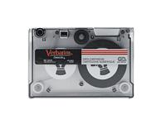
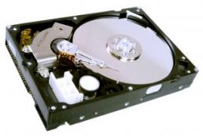
Transaction log
t1
t₂ (now)
Last back-up
Transaction log

Slide 192
Transaction log
All changes are written to a transaction log before the transaction is reported complete
Flush log file after a back-up
Backup
slow, compressed, usually to tape or another machine
Transaction log
Fast, written to local disk
Recovery steps
Restore database from back-up till latest existing version
Replay transaction log to a given point in time

Slide 193
Recovery models
Writing a transaction log is expensive
Duplicates all data write operations
Do we always need it?
Various recovery models for different scenarios
FULL:
all data modification operations are logged
SIMPLE:
log written but space reclaimed after transaction commits
No ability to recover system from failure
BULK-LOGGED:
Simple operations logged as in full mode
Bulk operations are not logged (e.g. bulk insert, see later)

Slide 194
Minimal logging
D of ACID requires writing a log
Even if log is not kept after transactions commit
Log is almost always written
Cause a lot of problems during data loading (data ingestion, provisioning etc.)
Do we really have to write everything twice?
Once into the table once into the log?
There are situation when writing a minimal log is enough
A new data page is being created
Log records the fact of page creation but not the data
An empty table is being filled with rows
If transaction aborts we just throw the entire table away
Minimal logging has many constraints but is extremely useful

Slide 195
Replication
Making an operation copy of parts or the whole of a database
Replicas
Can me modified independently
Can be synchronized with the main database
Basically off-line copies of the main database
Take it with you on a laptop
Synchronize when in the office
Not so important in the age of Internet
Not for safety back-ups

Slide 196
Database mirroring
Highly available systems require redundant hardware
Keep operational copy of DB on at least two servers
On a failure the other machine takes up load
Requires instant synchronization between machines
Solution: replay transaction log on slave machine
Requires full recovery model
Log replay is part of transaction
Adds network latency to transaction time
Easy software solution
No load balancing, only one master, others are slaves

Slide 197
Fail-over clustering
Hardware solution to previous problem
Requires special, shared storage accessible to all cluster nodes
Supports load balancing
Entire cluster visible as a single machine from the outside

Slide 198
17. Data loading

Slide 199
Jim Gray’s laws for data warehouse design
Lots of data -> one server won’t be enough
Scale out to multiple machines instead of scale up
Many machines instead of big iron
Easy management and expansion are very important
Take computation to the data, not the data to the CPU
Moving data around takes much more time than processing
Try to solve problems within the database server, using SQL
Build servers with large storage and big CPUs
What are the 20 most important queries you want to answer?
In a generic data warehouse, queries are not known beforehand
Users (scientists) come up with their own ideas
Optimize databases for the 20 queries
Develop system gradually, from working version to working
Scientists want a working system as soon as possible
Don’t rush forward and add unstable features

Slide 200
Typical loading pipeline steps
Analyze source data
Design database schema
Design indices
Design data layout (file groups)
Allocate database
Load data
Build indices
Build client applications / user interface

Slide 201
Scientific data formats
In most cases, text files
For historicaly reasons there are many„standard” formats
e.g. astronomy: FITS
Many projects use own ad-hod data formats
In worse cases, the format is binary
First step when building a database
Make data readable, and quickly readable

Slide 202
Data loading
Bad approach
Row-by-row with individual INSERTs
Not effective, INSERTs run their own transactions
Everything formated to text etc.
Better approach
Use a client library the support SQL pre-compile
ADO.NET, ODBC, JDBC, SqlAlchemy etc.
Pass data as parameters
Transactions of 1000-10000 inserts
No need to convert input files, loader program will do that
Sophisticated data conversion logic can go into loader program

Slide 203
Bulk data loading
BULK INSERT
Statement designed for large data bulk loading
Optimized for large amounts of data
From simple binary or text formats
Input file format is restricted
Need to convert original input files first
Bulk insert does minimal logging
Other bulk loading tools
Depend on product
e.g. SQL Server’s bcp command line tool (import/export)

Slide 204
First steps of data loading
Download RAW data
Scientific data is always dirty
File formatting error, unexpected value, missing data
Invalid cross-references in data
Out of range values, etc.
Requires lots of validation
Verify list of files, consistency of individual files
MD5 is much stronger than TCP/IP checksum
Convert input file to format compatible with BULK INSERT
Organize load job into batches of about 100 GB each
It’s good if data is already ordered by primary key

Slide 205
Load into loader tables
Loader tables are in a seperate database
Not the final destination of the data
Not indexed, only if data sorted
If data not sorted originally, no primary key either
Prevent (re)sorting of data during load
Necessary indices can be created later, once all data are loaded
Bulk insert
Always load into empty table to prevent logging
Parallel loading into multiple tables is good idea

Slide 206
Postprocessing loader tables
Verify consistency of loaded data
Unique identifiers
Interval of values
Verify foreign key consistency
Verify consistency with queries
Will need the list of problematic rows
Source data often needs to be fixed manually
Use text files first, if that works, move to binary
Data will need to be sorted to copy to final table
Build clustered index on loader table, or
Defer sorting to the copy operation

Slide 207
Copy to final tables
Once all load batches are finished and test completed
Create final tables with clustered index
Create clustered index before copy
Data have to be sorted before or during copying
Building clustered index later would be prohibitive
Implement queries to copy tables
Try to force minimal logging
(Re)build non-clustered indices on final tables

Slide 208
Merge new data
Problematic situations
Load tables are not disjoint in primary key
New data comes in that goes into the middle of existing primary keys
Need to insert new rows into already existing B-tree
Very expensive operation
Verify if key already exists
Make space for new rows in B-tree (page split)
Fully logged operation
Trick: set index fill factor to low to support inserts without page splits

Slide 209
Best practices
Use scripts instead of visual tools
Use source control to manage scripts (git, hg, svn)
Add comments to scripts
Scripts can contain meta-data (see later)
Advantage of using text files during loading
Much easier to find errors
Can be fixed manually
Load in smaller chunks
Repeat small chunk only if something goes wrong

Slide 210
Best practices cont’d
Test indices before build
Write query to verify uniqueness, range constraints
Rolling back index build is expensive
Test foreign keys
Foreign key constraints shouldn’t be enforced during load, would lead to bad performance
Need to be tested manually afterwards
Off-line indices
Turn off all non-clustered indices when merging
Can be rebuilt once merge is done

Slide 211
18. Meta data

Slide 212
Metadata in data warehouses
Scientific data
Have to no exactly what all those numbers mean
Unit but…
e.g. wavelenght in vacuum or air?
Automatic conversion between unit systems?
Derived quantities? e.g. energy/wavelength/velocity
Measurement instructions: exact description of measuring process and calculations
Can be very complex
Need to characterize veracity, reliability of data
Need semantic information
Additional data about the data schema
Connect data model with reality

Slide 213
Meta data
Meta data for humans and software
Build software that understands meta data
Can combine necessary data automatically
Simple case: find columns storing celestial coordinates
Hard case: convert from wavelength to frequency
Meta data need to be standardized for each field of science
Not only data format
Data models + meta data + ontology
Fundamental for easy sharing of complex data

Slide 214
Ontology
Define a universe on things to describe
The part of reality we want to model
Collect all concepts of the universe
Concepts
Entity: something that exists physically or logically
Real or abstract
Physical quantity or law of physics (formula)
Property: anything that describes an aspect of an entity
e.g. spectral type of a star, instructions to measure a unit
Relation: anything that can connect two entities
e.g. a star has an exoplanet, a galaxy is near another

Slide 215
Structured ontologies
Concepts of an ontology organized as a
Graph: Nodes are entitites, edges are relations, properties are tags
Hierarchy: A graph that’s a tree
Hierarchy allows for simpler entity identifiers
use content descriptors in meta data of data column
e.g. em.wavelength.ir

Slide 216
Data provenance
Provenance: originally the history of an object, piece of art etc.
Knowing the source of scientific data is fundamental
How much data can be trusted
What if we just downloaded from the Internet
How measurement were made
How derived quantities were calculated

Slide 217
Meta data
Additional data belonging to tables and columns
Content identifiers based on hierarchical ontologies
Easier to interpret by software
Units
Provenance information
Data quality information
Measurement errors, covariances
Confidence intervals, etc.
Also in human readable format
Display on web page of database

Slide 218
Semantic data systems
Intelligent client software that can automatically discover meta data
Answer questions based on metadata
Transform data automatically using physical laws
Convert wavelength to frequency to plot spectrum
Convert galactic coordinates to equatorial etc.
Semantic systems are still very immature
Require querying large graphs

Slide 219
Meta data in databases
Column name is not enough
SQL Server
Supports extended properties
Every object of the schema can be tagged with EPs
EPs can be queries with standard SQL
Include meta data in create table scripts
e.g. XML comments
Simple parser to process scripts and generate meta data
Meta data on the user interface
Web site can automatically generate documentation from meta data

Slide 220
Data warehouse registry
A data warehouse can contain hundreds of databases
Need a thorough description of everything
Hardware: what machines where
Software configuration of machines
Databases: where what data in what format
Where to direct a computation given its data and processing requirements
Minimize data movement
Services available

Slide 221
Data warehouse registry
Searchable
Find databases service a given type of data
Find services doing a certain type of operation
Find machines having a certain type of resource
Future goal
Formulate scientific problem declaratively
Data warehouse or warehouses work together to come up with a solution to the problem
Humans only superwise process, no actual coding
Registry as the basis of such systems

Slide 222
19. Multidimensional data

Slide 223
Multidimensional datasets
3-dimensional space with Euclidean metric
Higher dimensional space
Phase space in time (location, velocity, time)
Parameter spaces (e.g. colors of galaxies in 5 filters)
Surface of the sphere: Earth, sky
Spherical polar coordinates
3D unit vectors
Geographic information systems (GIS)
Point clouds
Suggested reading Hanan Samet: Foundations of Multidimensional and Metric Data Structures, Morgan-Kaufmann

Slide 224
A few fundamental problems
Find points in a given region of space
Region is given with analytic description
Equation of sphere, rectangle, polihedron etc.
Find nearest neighbor of a query point
Find k nearest neighbors
Also for cluster finding
Point classification (machine learning)
Non-parametric regression, non-linear regression
Estimate continuous density field from discrete points

Slide 225
Fundamental problems cont’d
Cluster finding in point distributions
Trajectories in space and time
Lagrangian mechanics
Outlier detection
Find points with unusual properties
Fast generation of histograms
For analysis and visualization
Volume rendering methods
Correlation functions (pair and higher order)
Interactive visualization of large point clouds

Slide 226
Relational databases for point clouds
Advantages
Optimized disk and memory access
Parallel query execution
Disadvantages
Storage system is one dimensional
RDBMS indices are designed for 1D data
Goal
Map multi-dimensional data structures to one dimension
Plan
Plane/space/hyperspace split into cells somehow
Cells are numbered observing locality: close cells have nearby numbers
Build index on cell numbers

Slide 227
K-dimensional indices
Spatial index
Data points with k coordinates
Data points often with error (smeared points)
Euclidean metric
Simplest case
Can have different scale for each dimension
Metric scaled with error in each dimension

Slide 228
K-dimensional indexing plan
Split space into small cells
Grid, hierarchical, etc.
Number cells with integers
Assign numbers observing data locality
For each data point, find corresponding cell
Tag data point with cell number
Build index on cell tags
Points in a cell can be queried by scanning and index range – very fast

Slide 229
Space tessellation
How the multi-dimensinal space or the sphere’s surface is split into cells
Single-level or multi-level tessellations
Hierarchical tessellations
Absolute and adaptivel tessellations
Adaptive: follow uneven distribution of data

Slide 230
Grid
Cells are defined by a grid in k dimensions
Grid is usually defined by orthogonal vectors
Different scales are possible
Advantages
Grid structure is well defined, cell vertices are easy to compute
Adjacent cells are very easy to find, depends on numbering scheme
Disadvantages
Number of cells is very high in higher dimensions, scales as k^n
Non-adaptive: can be lots of almost empty and crowded cells
Cell numbering
Must observe locality
Usually recursive algorithms, space filling curves

Slide 231
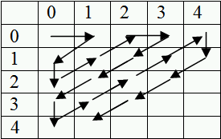
Numbering a grid with Cantor’s method
A not so good method
Close cells get distant numbers
Formula to compute number from grid coordinates is complex
Binary representation of cell ID has no meaning (see later)

Slide 232

Z-ordering
Good locality
Nearby cells have close numbers
Binary representation reflects hierarchical structure
Quad-tree
Most common method

Slide 233
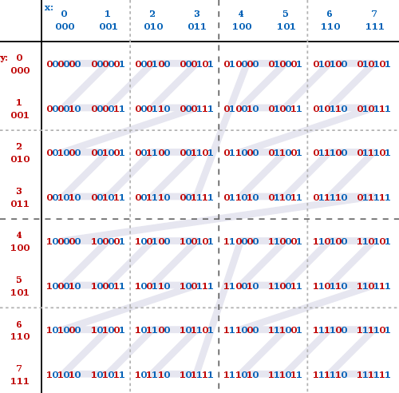
Morton coding

Slide 234


Peano-Hilbert curve
Space filling curve
Length of curve grows exponentially with iterations
Not a fractal
1D manifold that fills entire 3D space in limit
Better locality than Z-ordering
Binary representation also reflects hierarchy

Slide 235
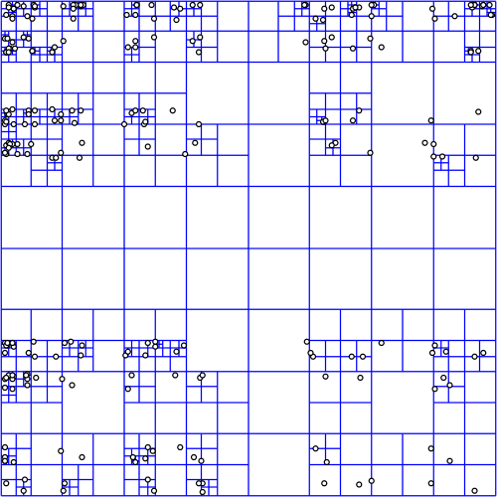
Quad-tree
To index 2D data
Every cell split into 4
Build a tree from cells
Easy to compute vertices
Morton coding
No need to build all the way
Leaf cells may contain multiple data points
Tree is not balanced
Empty leaf cells
Not ideal for clustered points

Slide 236
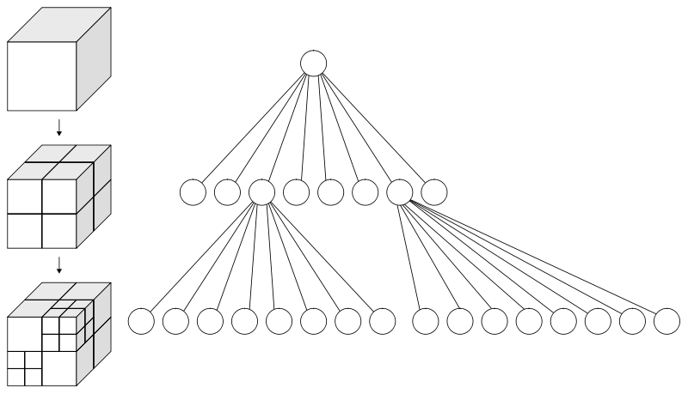
Octree
Same idea as Quad-tree
In 3 dimensions

Slide 237

Voronoi tessellation
Compute Voronoi diagram
Seeds are data points or a random subset of data points
Find cell containing a point
Walk along neighboring cells
o(sqrt(N))
Can be done hierarchically
Local density estimation
Inverse of cell volume
Usually too complex to implement in high dimensions
Too many vertices
too many neighbors
QHull algorithm

Slide 238
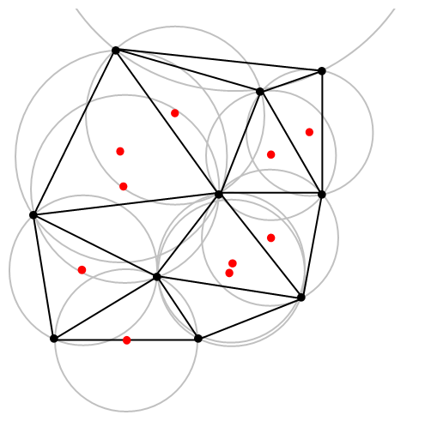
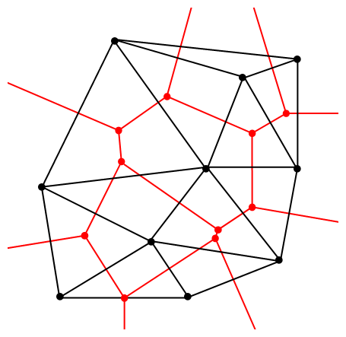
Voronoi and Delaunay

Slide 239
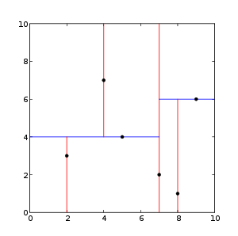
kD-tree
Algorithm
Find bounding box
Find median along first dimension
Split box into half at median
Repeat recursively for both new boxes
Median requires sort
expensive
estimated with average
Good in higher dimensions
Need to store vertices
Cell ID binary representation follows tree hierarcy

Slide 240
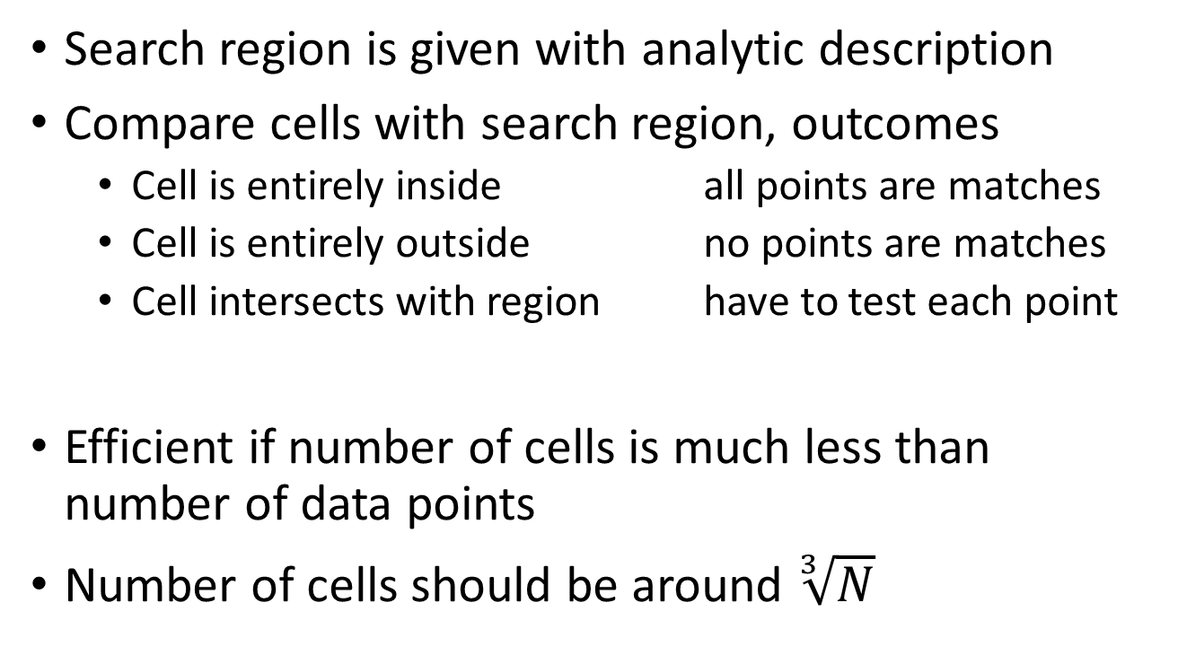
Spatial search
Search region is given with analytic description
Compare cells with search region, outcomes
Cell is entirely inside all points are matches
Cell is entirely outside no points are matches
Cell intersects with region have to test each point
Efficient if number of cells is much less than number of data points
Number of cells should be around $\sqrt[3]{N}$

Slide 241
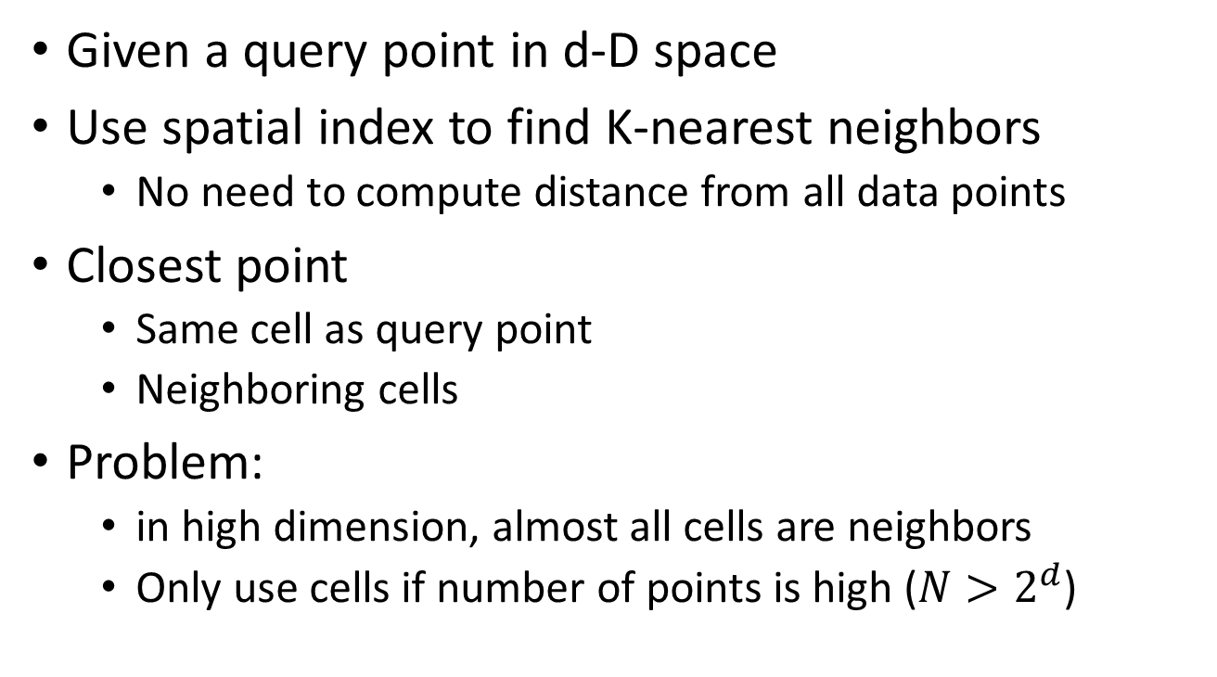
K-nearest neighbor search
Given a query point in d-D space
Use spatial index to find K-nearest neighbors
No need to compute distance from all data points
Closest point
Same cell as query point
Neighboring cells
Problem:
in high dimension, almost all cells are neighbors
Only use cells if number of points is high ($N>2^{d}$)

Slide 242
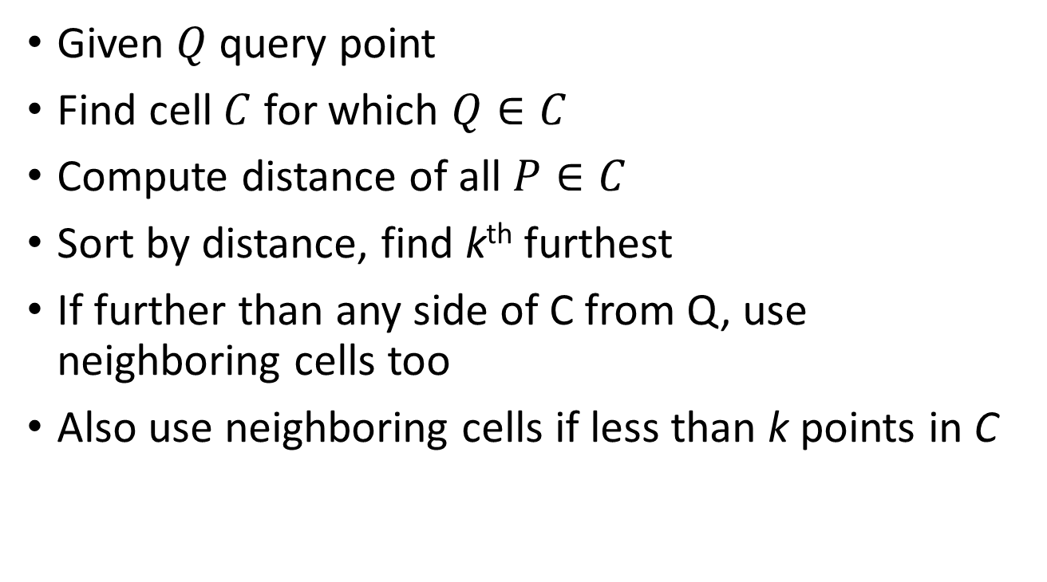
K-nearest neighbor algorithm
Given $Q$ query point
Find cell $C$ for which $Q∈C$
Compute distance of all $P∈C$
Sort by distance, find k^{th} furthest
If further than any side of C from Q, use neighboring cells too
Also use neighboring cells if less than k points in C

Slide 243
Classification
Supervised
Start from a training set
A sample for which we prescribe classes
e.g. nearest neighbor, friend-of-friend, SVM etc.
Unsupervised
Algorithm figures out classes itself
e.g. K-means clustering
Can be accelerated using spatial indices

Slide 244
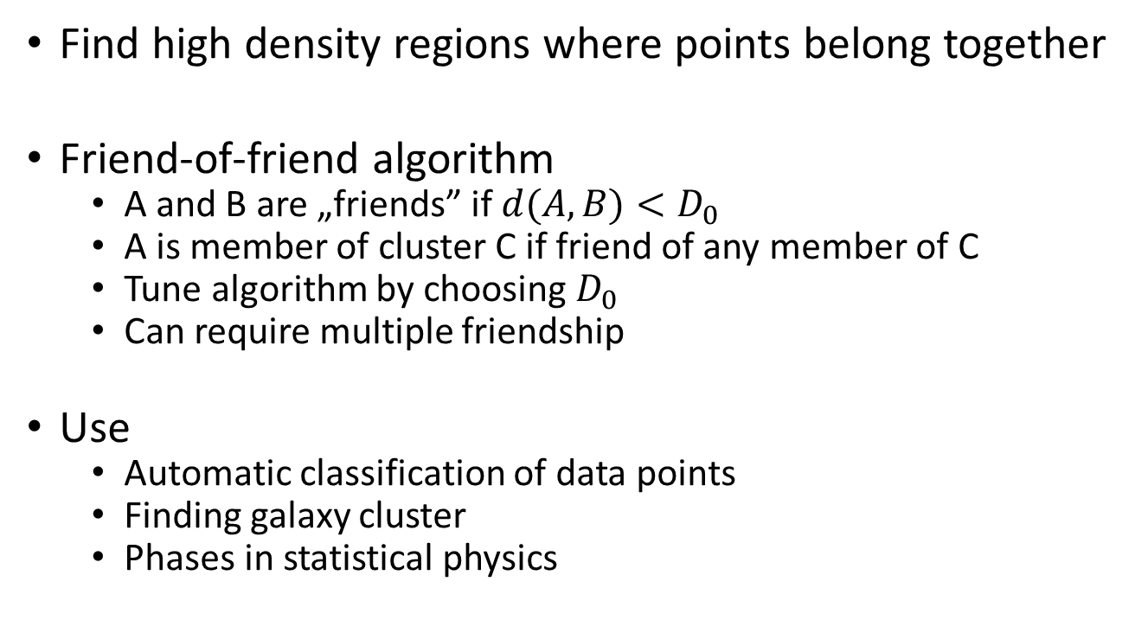
Cluster finding
Find high density regions where points belong together
Friend-of-friend algorithm
A and B are „friends” if $d(A,B)<D_{0}$
A is member of cluster C if friend of any member of C
Tune algorithm by choosing $D_{0}$
Can require multiple friendship
Use
Automatic classification of data points
Finding galaxy cluster
Phases in statistical physics

Slide 245
Non-parametric regression
Parameters with continuous values
Parameters of Q are not known
Find nearest neighbors of query point
Esitmate P of Q from P of neighbors
Local linear regression
No need for a global model
Empirical method: uses a training set

Slide 246
Histogram computation
Fast binning of data points on a regular grid
Often no exact values are required
e.g. for visualization, good estimates are enough
Point density in a cell of data space
A possible idea
Tessellate data space, index points with cell ID
Compute statistical quantities in each cell and store
Count, average, variance etc.
Compute intersection of cells and histogram bins
Estimate histogram from precomputed statistics

Slide 247
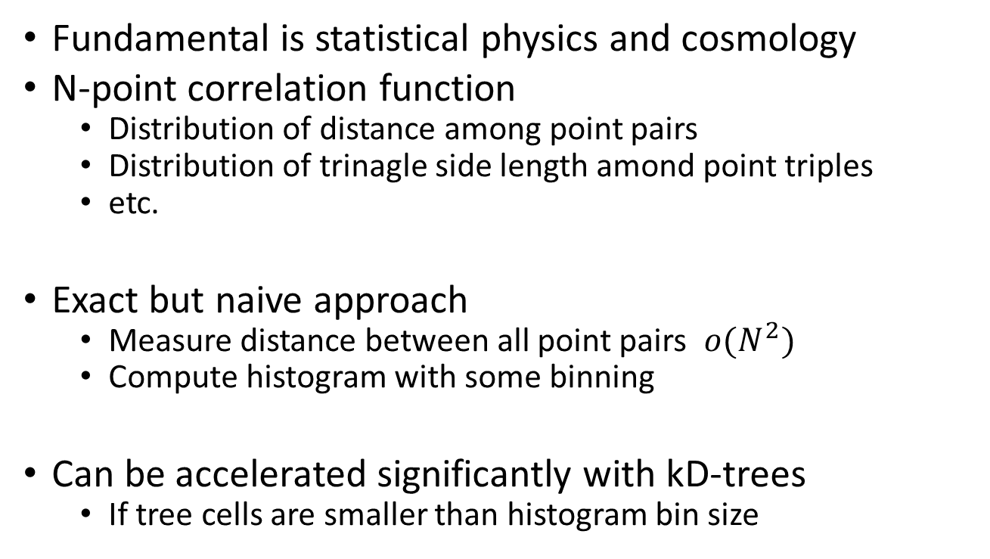
Correlation functions
Fundamental is statistical physics and cosmology
N-point correlation function
Distribution of distance among point pairs
Distribution of trinagle side length amond point triples
etc.
Exact but naive approach
Measure distance between all point pairs $o(N^{2})$
Compute histogram with some binning
Can be accelerated significantly with kD-trees
If tree cells are smaller than histogram bin size

Slide 248
Adaptive visualization
All points cannot (and shouldn’t) be displayed
We want to zoom interactively on regions of data space
Looking from far
Enough to give a sense of point density
Display random points, use alpha, volume rendering
Looking from close
Display individual data points
Allow point selection, manipulation, etc.

Slide 249
Preconditioning spatial data for indexing
Best practice:
keep space cells as close to spheres as possible
Cubes, hypercubes
Data whitening
Subtract average
Normalize with variance along coordinate dimensions
High dimensional data often located on along lower dimensional manifolds
Dimensionality reduction
Principal Component Analysis (PCA)
More advanced, non-linear methods

Slide 250
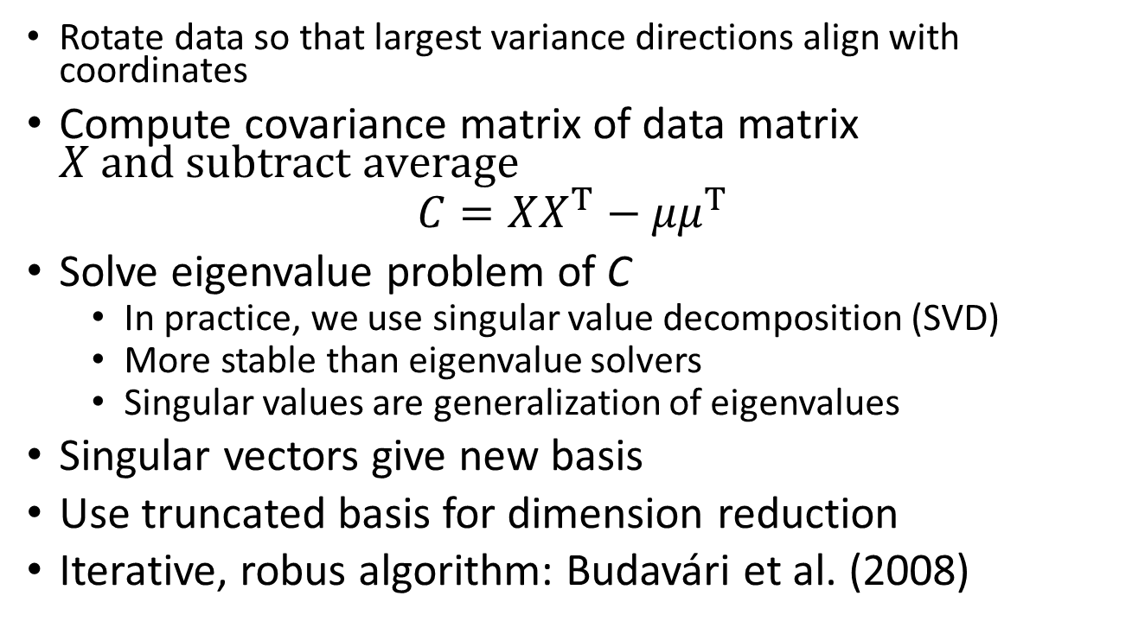
Principal axis transformation
Rotate data so that largest variance directions align with coordinates
Compute covariance matrix of data matrix $X and subtract average$
$$C=XX^{T}−{μμ}^{T}$$
Solve eigenvalue problem of C
In practice, we use singular value decomposition (SVD)
More stable than eigenvalue solvers
Singular values are generalization of eigenvalues
Singular vectors give new basis
Use truncated basis for dimension reduction
Iterative, robus algorithm: Budavári et al. (2008)

Slide 251
20. Indexing the sphere

Slide 252
Spherical indices
Problems: topology of the surface of the sphere
Spherical coordinates
Discontinuity at -180°-+180°
Singularity at the poles
Need to address problem algorithmicly
Numerical instability around the poles causes lots of problems
Frequent solution:
Use Cartesian unit vectors instead of spherical coordinates
Indexing the sphere
Tessellate surface, tag cells with numbers
Assign data points to cells, index them by the cell IDs
Earlier methods can be generalized: Quad-tree, Voronoi
Need to rewrite all algorithms due to periodic topology

Slide 253


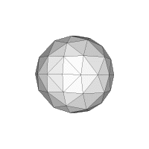
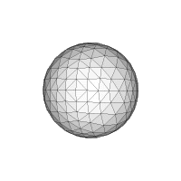


Hierarchical Triangular Mesh (HTM)
Estimate the spherical surface as a mesh of triangles
Small triangels: trixels
Algorithm
Start from an octahedron
Split triangles into four smaller ones by finding the centers of sides
The result is a Quad-tree

Slide 254
HTM properties
Advantages
Easy to compute mesh, hierarchical
Fast search algorithms possible
Disadvantages
Region search algorithms are quite complex
Triangle size and shape varies slightly around the sphere
Implementation Fekete, Budavári & Szalay

Slide 255

Morton coding HTM trixels

Slide 256


HEALPix
Hierarchical Equal Area isoLatitude Pixelisation
Cells are equal in area
Important for many applications
Numerical spherical harmonics expansion
Implementation: NASA

Slide 257

Hierarchical structure of HEALPix

Slide 258
21. GIS in MSSQL

Slide 259

Spatial data in MS SQL Server
Two basics types
Geometry: for planar data
Geography: for spherical data
For example, geometry classes

Slide 260
Creating geometries
Create column with type ‚geometry’
Implemented as a varbinary(max)
Shapes are represented as strings or binary
WTK: well-known-text
WTB: well-known-binary
Geometry can be a combination of many classes
Point, polygon, etc.
Syntax
INSERT INTO GeometryTable (POINT) VALUES (geometry:STPointFromText(‚POINT (20 30)', 0));

Slide 261
Methods on geometry type
Simple methods
ToString
STGeometryType
STNumPoints
STDimension: 0, 1 or 2
Important but expensive properties
STLength, STArea
STBuffer: grow region
Operations between regions
STIntersection, STUnion, STDifference

Slide 262
Spatial queries using geometry
Function to be used
STEquals, STDisjoint, STIntersects, STTouches, STOverlaps, STCrosses, STWithin, STContains, STRelate, STDistance
Query example:
SELECT ID, Point.ToString()
FROM GeometryTable
WHERE Point.STWithin(geometry::STGeomFromText( 'POLYGON ((0 0, 150 0, 150 150, 0 150, 0 0))', 0)) = 1
How is this query optimized?

Slide 263

MS SQL Server spatial index
Built on geometry and geography columns
Sphere is projected to the plane first
Four-level grid
Store list of touched cells

Slide 264

Tessellation
Store list of touched cells
Limit length of lists
Extensive pruning to control index size
Might not be worth it! See: Kondor et al. (2013)

Slide 265

Geography to geometry
Project regions to the plane
Use same indexing developed for planar geometry
Problems with regions crossing the equator
Efficient in handling polar singularities

Slide 266
22. Advanced storage techniques
From compressed databases to column stores

Slide 267
Compressed databases
Use compressed file system
Unpredictable performance with databases
In MS SQL restricted to read only data
Compressed tables
Simple, fast, yet effective compression algorithms
Smaller data
faster access on the disk
Higher CPU load, need to decompress
Can compress tables and indices
ROW or PAGE level compression

Slide 268
ROW level compression
Compress meta data on row level
Store fixed-length values as variable length
bigint: omit leading zeros, save a byte or two
Omit trailing spaces in fixed-length strings
UTF-8 encoding for unicode instead of two bytes per char
Only works if row fits on page (< 8000 byte)

Slide 269
PAGE level compression
Prefix compression
Rows on page are ordered by index key
Very similar IDs repeat throughout the page
e.g. first 10 digits of ID are the same
Store prefix only once, store difference only
Dictionary compression
Same value might repeat in other columns too
Name of cities, flags, zeros
Build dictionary, store reference only

Slide 270
Partitioned tables
Every table and index is mapped to a file group
Or a partitioning scheme (set of file groups)
Define disjoint, adjacent intervals of key values
Partitioning function defines key ranges
Partitioning scheme maps ranges to file groups
Each interval can go into its own file group
Advantages
Ability to stora parts of tables on dedicated disk
e.g.: old data compressed, read-only on slower disks
No need to rewrite queries for partitioned tables
Partitions can be switched on and off (useful during loading)
Partitioning is not for performance
Yet, there is no significant performance hit

Slide 271
Table and index partitioning
TABLE
IDX 1
IDX 1
FILE GROUP 1
FILE GROUP 2
Partitioning function + scheme
FILE GROUP 3
FILE GROUP 4

Slide 272
Relational Database clusters
RDBMS is not designed for scale-out
ACID operation
Distributed joins is a known hard problem in general
There are simple cases which can be solved
Database Server clusters
Identical or very similar hardware running large DBs
High-speed, reliable network (big data transfers)
Mainly read only databases

Slide 273
Goals with distributed databases
Split large database among many servers: sharding
Replicate data instead of back ups
Many options to achieve redundancy
Mirror databases
Parallelize queries for higher IO throughput
Higher availablity
Load balancing
Regular data loading tasks
Dedicated load servers
Bulk insert, data validation, sorting
Faster to write storage

Slide 274
SkyQuery system: Mirror
SERVER 1
SERVER 2
SERVER 3
SERVER n
A
A
A
A
B
B
B
B
C
C
C
…
C
D
D
D
D
SERVER U
UserDB
Specially partitioned queries run in parallel on n servers
All servers use to answer single query
Non-partitioned queries in round-robin for load balancing
Query results are collected in UserDB
UserDB

Slide 275
PanSTARRS: sharded database
SERVER 1
SERVER 1
SERVER 1
SERVER 1
A1 HOT
A4 HOT
A2 HOT
A5 HOT
A3 HOT
A6 HOT
An-3 HOT
An HOT
A2 WARM
A5 WARM
A3 WARM
A6 WARM
A4 WARM
A7 WARM
An-2 WARM
A1 WARM
A3 COLD
A6 COLD
A4 COLD
A7 COLD
A5 COLD
A8 COLD
…
An-1 COLD
A2 COLD
SERVER L1
SERVER L1
Three copies: hot, warm, cold
Load data to LoadDB
Merge new with old data on nodes into cold version
Query across servers
Query results go to UserDB
SERVER U
LoadDB
LoadDB
UserDB
LoadDB
LoadDB
UserDB

Slide 276
Column-store
RDBMS traditionally row oriented
B-trees to log N seek time
Organized in pages, clustered index, etc.
In-place updates and deletions
Optimal for transaction processing, frequent updates
Page size is small: 8 kB
Not optimal for large scan operations
Problems
Wide tables, all columns stored sequentially
Have to read rows that aren’t necessary to answer query
Idea: store table column by column
Same data type
Sorted data are very similar: heavy compression is possible

Slide 277

Column-store concept

Slide 278
Tables and projections
Table
collection of columns
Projection
A subset of columns of a table
Sorted in the same order
Key is one of the columns of the projection
Multiple projections of a table
With different ordering
Equivalent to indices
Every projection takes up space on storage

Slide 279
Join indices
Mapping between two projections
Need to store pointers because ordering is different
We need the entire table
Only union of projections P1 and P2 have all columns
P1 and P2 sorted differently
Need an index to connect P1 and P2
Store row IDs of P2 in the order of P1
Or vice-versa

Slide 280
Column-store storage model
Use big chunks of column instead of B-tree
1 M rows
Chunks can be sorted but
Not too big for linear search
Build index on slab on-the-fly, in-memory
Columns within projection with same sorting
Easy to calculate position of row within chunk
Fix column size, no variable strings
No need to store pointers, unless pointing to different projection

Slide 281
I/O savings
Large slabs are fast to read
128 Mb is enough for efficient sequential read from disk
Similar value follow each other
Good compression ratio
Agressive compression algorithms
Can reclaim space lost by storing table columns more than once
Sacrifice CPU cycles for better net storage bandwidth
In terms of rows per seconds vs. bytes per seconds!
Many operations can be done without uncompressing data
e.g. COUNT(*)

Slide 282
Column-store main disadvantage
Data modification is very expensive
Have to modify all projections
No in-place deletes
No B-tree
Insert is not just a page split but need to move most records of a slab
Workaround: (e.g. c-store, vertica)
Store modifications in small temporary table
Update read-only column-store regularly
Query column-store than include temporary tables

Slide 283
SQL Server column-store
Column store is good but best if part of comprehensive database solution
Modern database product
Transaction processing + data warehousing
Row store + column-store + in-memory tables
SQL Server implementation
Column-store as storage method for tables
Column store tables are read-only
Only bulk load

Slide 284
Cursors
Row-store physical scan operations
Returns a cursor
Cursor has fetch() function to get next row
Returns entire row
Called frequently in innermost loop of consumer operator
Fetch() function can be very complex
Page pool handling (load data from disk)
Evaluate expression, projections etc.
Many CPU instructions, fetch() is expensive
Does not fit well into CPU cache
Lose memory locality due to complexity
Very hard to optimize for CPU

Slide 285
Address-continous storage
Columns-stores
Struct of arrays instead of array of struct
Data stored continuously is memory
Only data, not headers, footers, pointers, etc.
Use simplest for loop instead of cursor
„Vectorization” of scan operations
Can easily be 100 times faster than cursors
Use SSE statements, etc.
Large room for parallelization
Can be optimized for the CPU well

Slide 286
23. RDBMS in the future

Slide 287
Development directions
Column Store
JIT compilation, vectorized execution
Continuous scan (Ferris wheel)
Distributed databases – scale-out
Array data model

Slide 288
Continuous scans
RDBMS optimize scan operations very well
Table scan, index scan
Fundamental function of data warehouses
Full table/index scan
Often the only way to answer a query
Huge tables, can take a very long time (hours)
Large IO cost
More than one queries might scan same table
Could bundle scans together
But queries are started at arbitrary times

Slide 289

Ferris Wheel
Hop on-hop off at the bottom
Reuse scan operations for new scan queries
Queries „hop on” already running scans
Restart scan from the beginning, if necessary
Scanning stops if all queries are completed
Implementation: IBM DBII

Slide 290
Jim Gray’s two important laws
Scale-out
Processing big data is only possible by parallel systems
Data movement
Take computation to the data and not the data to the CPU

Slide 291
Distributed RDBMS
Data partitioning: sharding
Vertical partitioning
Key ranges on separate servers
Functional partitioning
Horizontal partitioning
Certain columns, tables on separate server
Replication
Higher redundancy and availability
Load balancing
No need for old-style back-up
+ combinations of these

Slide 292
Problems with distributed databases
Slow network
Very fast IO within server
Fast switch within rack
Limited bandwidth between racks
Geo-redundant system: high network latency
Co-location awareness
System must benefit from locality of data
Organize jobs such a way that data movement over network is minimal
Replication
Multiple copies of data on different servers
How to update replicas consistently
How to do synchronization without degrading performance

Slide 293
Distributed read operations
Sharded table distributed accross multiple servers
Scan ✓
Read all rows exactly once
Sort ✓
Quick sort withing shard, merge sort afterwards
Key lookup ✓
Shards are defined by key ranges
Server holding a key is always known
Join ?
In general, a hard problem

Slide 294
Distributed joins
Theory says it cannot be solved in general
Optimalization problem
Minimize data movement over network
How to organize data to achieve this
How to process query to achieve this
Very hard to tell the cardinality of the output of a general JOIN operation
Only a few implementations
Often not part of RDBMS but a layer on top of it
Usually limited support of operations
MySQL Cluster, SQL Server Azure
Microsoft Parallel Data Warehouse, Oracle Exadata, Greenplum

Slide 295
Distributed join ideas
Mirror everything to all servers
Easy to parallelize
Requires lots of storage space
Copy smaller table where the big tables are
How to benefit from the filters in the WHERE clause
Smart statistics are needed
Compute statistics on the fly
Randomly sampled, small versions of large tables
Mirror small tables to every server

Slide 296
Distributed join ideas 2
Tables are sharded on primary key of largest table
Always partition joins on this key
INNER JOIN can be performed within shard
Lazy-join
Vertically partitioned of table
Usually most columns are rarely used
Move rarely-used columns to slower server with large storage
Execute all joins first, then collect lazy-columns
Do not allow lazy columns in JOINs

Slide 297
Distributed join ideas 3
Smart caching of remote tables
Join require copying parts of remote tables to the server which will perform join
Cache remote tables locally for a while
Cache efficiency depends highly on query patterns
Whar columns, what rows?
How selective WHERE clauses are?
Three-way, four-way join even more complicated
Order of join processing is very important
What about cyclic joins? Self joins? Cross joins?

Slide 298
24. Array-stores

Slide 299
Array data model
Scientific data
Multidimensional data
Position, value, error etc.
Mostly numbers (fixed-size values)
Array: d dimensions
Data cell identified by d number (indices)
Indices are integers: arrays
Indices are doubles: point clouds
Time steps, time intervals, continuous time values

Slide 300
Array in the relational model
CREATE TABLE array ( i1 int, i2 int, i3 int, data float)
Need to store indices
Extreme waste of storage
Need entirely different storage model

Slide 301
Array slicing and dicing
Slice along a given dimension
Integrate along a given dimension
Reshape array
Rotate indices
Cut out sub-array
Optionally integrate along other dimensions

Slide 302
Physical storage of arrays
Dense arrays: most cells contain data
Store empty values, do not store indices
Sparse arrays: most cells are empty
Store indices, do not store empty values
Good also for continuous indices (float)
Very similar to point clouds
Dense array storage
Slice up array to small cubes
Will keep data locality on the disk
Cubes can have „buffer zones”, duplicates along the sides
Slice in every dimension
Same price of disk access regardless of dimension
Arrays of composite values (structs)
Store values together or separately
Same idea as column-stores

Slide 303
Querying array databases
SQL is for tables (1 dimensional arrays)
Adapt concepts from SQL to arrays
ARRAY, similarly to TABLE, is a first-class citizen
Declarative programming model
Physical operators
Query optimizer
Will need
Language constructs to generate sequences (for indexing)
Slicing and dicing constructructs, like Matlab
A(1000::100,:,1:2) etc.

Slide 304
Aggregate function
Can be used to „integrate” along a dimension
SELECT SUM(a[x, y]) FROM a GROUP BY [x]
Result is a 1D array, indexed by y only
Square brackets in GROUP BY indicate integration along index

Slide 305
Kernel functions
Kernel functions generalize aggregates
Can reference „nearby” cells of array
SELECT 0.25 * a[x-1] + 0.5 * a[x] + 0.25 * a[x+1] FROM a GROUP BY [a]
Array cells are referenced with respect to an anchor [x]
Combination of referenced cells is the kernel
For fast execution, all referenced elements need to be in memory
More similar to a JOIN than an aggregation
Tricky to solve on cube boundaries

Slide 306
Kernel function implementation
RDBMS: precompiled physical operators
Actual query execution is interpreted
Projectors
Mathematical expression
Kernel function evaluation cannot be interpreted
Billions of executions, e.g. when rescaling an image
Compile to machine code is a must

Slide 307
JIT kernel compilation
Server image cannot be recompiler for every query
JIT: just in time compilation
No on-the-fly code generation
Query compiled as a module
Loaded into the server process
Would require significant parts of server source code to be open
Most database systems are written in C
Very slow to compile
No support for JIT
Would be platform dependent
Managed langu (c# java) have too much overhead
Own assembler+compiler (e.g. monet db)

Slide 308
rasdaman
Raster Data Manager
Array database developed for geophysics
Large, multi-layer satellite imaging
Data processing + visualization
Multi-layer images stored as tiny cubes
Efficient integration along axes
Fast interpolation
Use RDBMS and backing storage
Array manipulation implemented as a client library
Works with various products (postgres, oracle)

Slide 309
SciDB
Designed specifically for scientific purposes
Data management and analytics
Only arrays, no tables but can mimic them
Own query language
Query optimizer
Ability to construct query plan directly
Scale up from laptops to servers
Scale out to server clusters and clouds
Minimal support of transactions
Only roll-back on error, no isolation
Flexible integration of remote data sources
Important for scientific data
Version handling, provenance

Slide 310
25. noSQL databases

Slide 311
Inspiration: web 2.0
Search engines, giant webstores, social web
Exponential growth at the beginning
Big iron machines could not follow
Exponential data growth
Less structured data – social web
High availablity was a major requirement
Consistency was less important
RDBMS 

Slide 312
Distributed systems
High demand for distributed database systems
1000+ nodes from commodity servers
Shared nothing approach
Node failures are common and handled routinely
Scale-out of RDBMS still not solved
Major problems: consistency, distributed joins
There are attempts: mySQL cluster (ndb), graywulf etc.
Solution: implement something from scratch

Slide 313
noSQL (not only SQL)
Urgent demand for new technology
RDBMS systems are extremely complicated
Large codebase, changes take month to implement
Let new technology be much simpler but must scale-out
Where can we save on complexity?
No SQL language, or very limited syntax
No declarative programming model (imperative is simpler)
No relational data model (see later)
No generic scan and join operations
No ACID, simplified transaction and consistency model
BASE (see later)

Slide 314





Two major fields of noSQL
Large-scale data processing
Regular batch processing
Reduction of Big Data
Scan operations
High throughput transaction processing
Load balancing over nodes
Random operations
Replicate data (instead of back-ups)
Data durability
Load balancing

Slide 315
Hadoop
Based on a google paper, Apache Project written in Java
HDFS: Hadoop Distributed File System
Large files across multiple machines
Replicate data on multiple nodes
Job scheduler
Ensures job execution in a multi-machine environment
Co-location aware, minimizes data movement
Jobs need to be easily parallelizable
Parallel programming is usually very complicated
But can use simple building blocks to solve problem

Slide 316
Map/Reduce
Process data in smaller chunks (keys, key ranges)
Scheduler is responsible to assign worker to chunks
Functions can only see a chunk of data at a time
(except reduce; it gets multiple chunks)
Simple building blocks that support parallel processing
Filter: filter and sort input chunks
Map: process input to produce output chunk
Shuffle: redistribute chunks among workers
Reduce: combine multiple chunks into new ones
Pipeline consists of many layers of Filter/map/reduce
Layers share data by reading and writing HDFS
Bit room for improvement: share data in memory

Slide 317
Map/Reduce pros and cons
Advantages
Very easy to parallelize, almost unlimited scale-out
It works
Disadvantage: low level compared to SQL, but
PIG: high-level language to write hadoop jobs
HIVE: Query language and indexing for hadoop
Map/Reduce is not a new technology at all
Just reinvention + tinkering
Map/Reduce vs. RDBMS
RDBMS supports everything that MapReduce does
No distributed joins in Map/Reduce either
Hadoop files could be replaced by tables etc.

Slide 318
noSQL data models
No relational data model (tables, columns, joins)
Key-Value stores (Redis, mongodb)
Value can be complex type
Document (binary, xml, json, bson)
String, list, hash-table, array
BigTable (google, Hbase, Cassandra, Riak)
Rows with keys
Columns with names
Columns can be created dynamically
Columns organized into column families
Determines storage location
Key + column name = composite key -> key-value store
Object stores, graph stores etc.

Slide 319
noSQL basics
Basic operations
Find data by key
Modify data by a single key
Transactions are very simple
Modify data associated with a single key
No multi-step, parallel transactions
No need for complex isolation logic
No (or limited) scan operations
Have to build index for search
Indices have to be maintained
Most products have built-in index maintenance
Sometimes „by hand”

Slide 320
 | RDBMS | BigTable | Hadoop
Declarative language, query optimizer | ✓
Optimized scan operations | ✓ |  | ✓
Quick access by primary key | ✓ | ✓
Search by indices | ✓ | ✓
Join operations | ✓
Parallel query execution | ✓ |  | ✓
Easy sharding |  | ✓ | ✓
Transactions | ACID | BASE
Multi-step transactions | ✓
Durability | back-up/log | replication | replication
Simple load balancing |  | ✓ | ✓
Non-structured data support | ✓ | ✓ | ✓
Standard API | ✓

Slide 321
26. Consistency of distributed database
CAP theorem and its consequences

Slide 322
Consistency
C
Replication instead of back-ups
Data stored in multiple copies, on-line
How is consistency of replicas enforced?
Need some kind of replication protocol
Sync or async? Latency vs. consistency!
Usually asynchronous
Consistency window
Time period after which data are consistent

Slide 323
Availability
A
Data to be always available to clients
Through multiple access points
No single point of failure
Geo-redundancy
Response time should be minimal
Server with minimal latency to client
Minimize internal communication among replicas
Latency might be more important than consistency

Slide 324
Partition tolerance
P
Distributed system
Connected over network
Slow, sometimes unreliable
Multiple points of access
System should be operational even when split by network error
Partitions of the system cannot communicate
Clients can still use system by accessing different partitions
Distributed functionality
e.g. facebook login, photos, status, mailbox, chat etc.
Various parts of the system can lose connection to each other

Slide 325
CAP theorem
C
Only two of the three can be satistisfied at the same time
A
P

Slide 326
Relaxing the transactional model
ACID
Expensive for distributed systems (two-phase commit)
Transaction aborts on an error anywhere in the system
BASE
basically available, soft-state, eventually consistent
Assume a system where failure is normal
Handle errors optimistically
Effect of transactions is not synchronous
Changes spread across the system
In the form of message exchanges over the network
Over a (hopefully short) period of time

Slide 327
BASE
BA: basically available
Mostly in case of CP systems
At least part of the system should remain operational
Soft-state
Changes are done via async messages (gossip protocols)
Change propagation takes some time
State of the system can change, even if no input is received
Eventually consistent
Mostly in case of AP systems
Data values are valid only within a time frame
Consistency window
Outside the time frame data need to be validated
Becomes consisten after a while

Slide 328
Conflict resolution
Failures can cause inconsistencies among replicas
Need to find ways to resolve them
Use data types not prone to conflicts
Methods based on time stamps
Data with latest time stamp is considered valid
Might require finely synchronized clocks
Majority voting algorithms
Needs negotiation among servers
Paxos, nodes vote in quorums

Slide 329
References
Csabai et al. „Multidimensional indexing tools for the virtual observatory” 2007 AN
Dobos et al. „Array requirements for scientific applications and an implementation for microsoft sql server” 2011 EDBT/ICDT
Budavári et al. „Searchable Sky Coverage of Astronomical Observations: Footprints and Exposures” 2010 PASP
Dobos et al. „A Comparative Evaluation of noSQL Database Systems” 2014 Annales Univ. Sci. Budapest.
Microsoft SQL Server documentation
www.microsoft.com
www.nasa.gov
www.sdss3.org
Wikipedia ©©

